Slide 1
Visualizing Proportions and Enrichments
HUGEN 2073
Genomic Data Visualization and Integration
Slides borrowed/modified from H. J. Park with permission

Slide 2
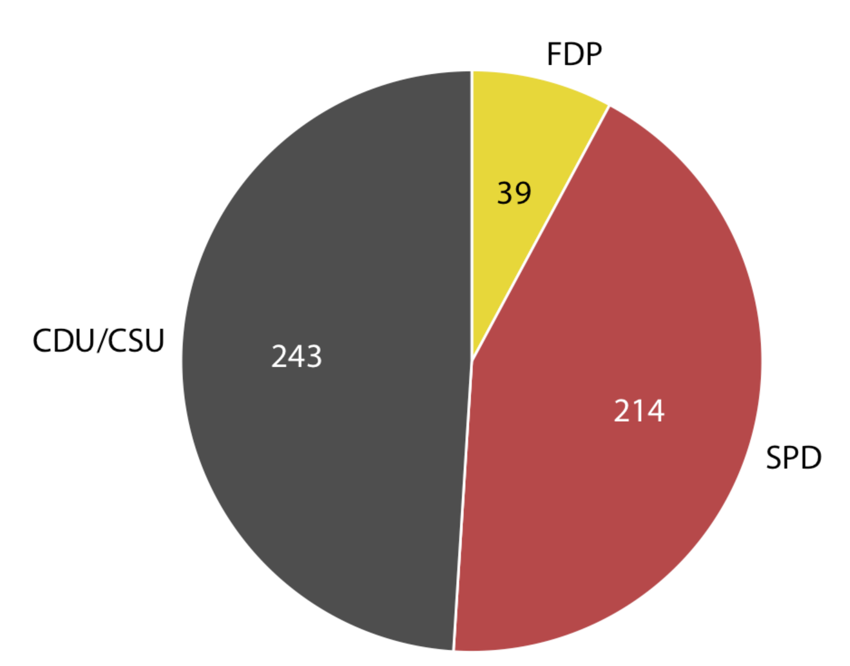
Pie charts to show proportions
Composition of expressed genes
Pros:
can show how some entity breaks down into pieces (e. g., n=496)
easy to read when the data amounts to an entirety
Cons:
Difficult to see the total number
Transcription factor
Housekeeping
Tumor-
associated
Adapted from Fundamentals of Data Visualization, Wilke, O’Reilly, 1st Ed.
Notes:
We often want to show how some group, entity, or amount breaks down into individual pieces that each represent a proportion of the whole. The archetypal such visualization is the pie chart, omnipresent in any business presentation and much maligned among data scientists.
For example, in the 8th Bundestag, from 1976–1980, the CDU/CSU held 243 seats, SPD 214, and FDP 39, for a total of 496. Such parliamentary data is most commonly visualized as a pie chart.
This visualization shows clearly that the ruling coalition of SPD and FDP had a small majority over the opposition CDU/CSU.

Slide 3
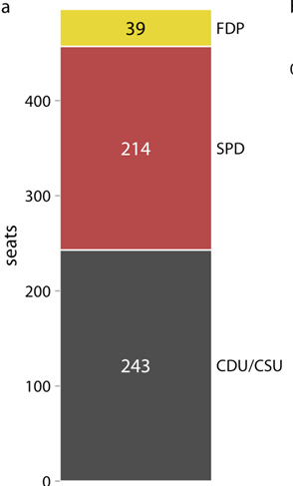
Stacked bar to show proportions
Composition of expressed genes
Pros: can show how some entity breaks down into pieces
Pros: easy to see the total number
Cons: less sense of totality (there might be other classes)
Transcription factor
Tumor-
associated
# genes
Housekeeping
Adapted from Fundamentals of Data Visualization, Wilke, O’Reilly, 1st Ed.
Notes:
A pie chart breaks a circle into slices such that the area of each slice is proportional to the fraction of the total it represents. The same procedure can be performed on a rectangle, and the result is a stacked bar chart (Figure 10.2).

Slide 4
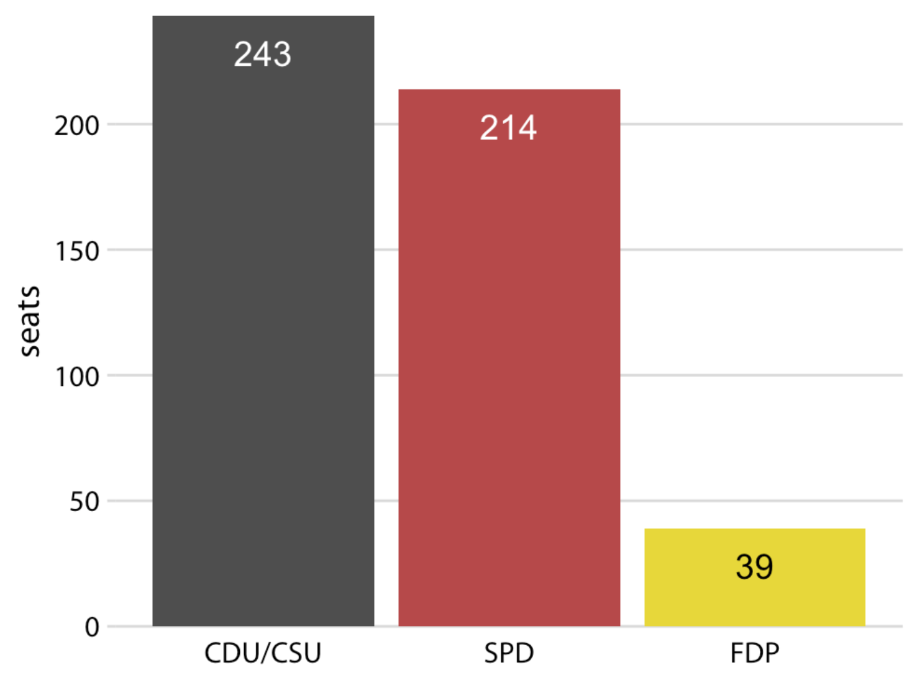
Side-by-side bar to show proportions
Composition of expressed genes
Pros: better to compare
Cons: the relationship of each to the total not obvious
can annotate percentage values
# genes
Housekeeping
Transcription
factor
Tumor-
associated
Adapted from Fundamentals of Data Visualization, Wilke, O’Reilly, 1st Ed.
Notes:
We can also take the bars from Figure 10.2a and place them side-by-side rather than stacking them on top of each other. This visualization makes it easier to perform a direct comparison of the three groups, though it obscures other aspects of the data (Figure 10.3). Most importantly, in a side-by-side bar plot the relationship of each bar to the total is not visually obvious.
Many authors categorically reject pie charts and argue in favor of side-by-side or stacked bars. Others defend the use of pie charts in some applications. My own opinion is that none of these visualizations is consistently superior over any other. Depending on the features of the dataset and the specific story you want to tell, you may want to favor one or the other approach. In the case of the 8th German Bundestag, I think that a pie chart is the best option. It shows clearly that the ruling coalition of SPD and FDP jointly had a small majority over the CDU/CSU (Figure 10.1). This fact is not visually obvious in any of the other plots (Figures 10.2 and 10.3).

Slide 5
Pie chart and barchart make different points
Q: Which is better to show when your message is that…
the combination of TF and TA jointly had a small majority over the HK or
HK is big compared to each of the others ?
Transcription factor
# genes
Housekeeping
Tumor-
associated
Housekeeping
Transcription
factor
Tumor-
associated
Adapted from Fundamentals of Data Visualization, Wilke, O’Reilly, 1st Ed.
Notes:
We often want to show how some group, entity, or amount breaks down into individual pieces that each represent a proportion of the whole. Common examples include the proportions of men and women in a group of people, the percentages of people voting for different political parties in an election, or the market shares of companies. The archetypal such visualization is the pie chart, omnipresent in any business presentation and much maligned among data scientists.
For example, in the 8th Bundestag, from 1976–1980, the CDU/CSU held 243 seats, SPD 214, and FDP 39, for a total of 496. Such parliamentary data is most commonly visualized as a pie chart.
This visualization shows clearly that the ruling coalition of SPD and FDP had a small majority over the opposition CDU/CSU.

Slide 6
Pie chart and barchart make different points
Q: Which is better to use when there are
only those three gene groups or
other gene groups?
Transcription factor
# genes
Housekeeping
Tumor-
associated
Housekeeping
Transcription
factor
Tumor-
associated
Adapted from Fundamentals of Data Visualization, Wilke, O’Reilly, 1st Ed.
Notes:
We often want to show how some group, entity, or amount breaks down into individual pieces that each represent a proportion of the whole. Common examples include the proportions of men and women in a group of people, the percentages of people voting for different political parties in an election, or the market shares of companies. The archetypal such visualization is the pie chart, omnipresent in any business presentation and much maligned among data scientists.
For example, in the 8th Bundestag, from 1976–1980, the CDU/CSU held 243 seats, SPD 214, and FDP 39, for a total of 496. Such parliamentary data is most commonly visualized as a pie chart.
This visualization shows clearly that the ruling coalition of SPD and FDP had a small majority over the opposition CDU/CSU.

Slide 7
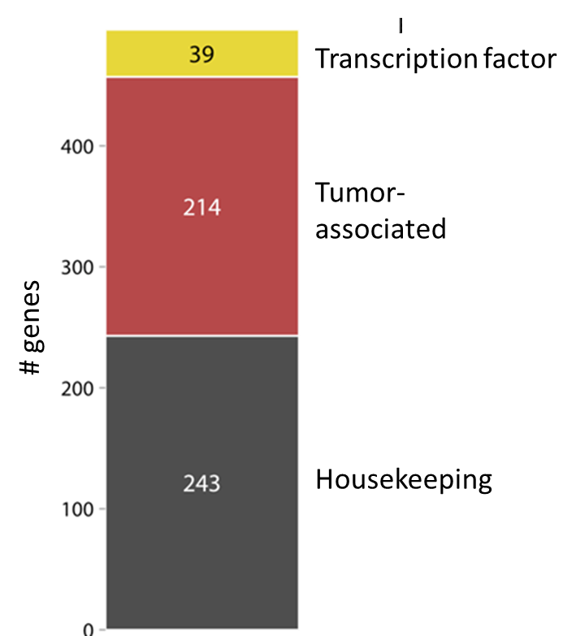
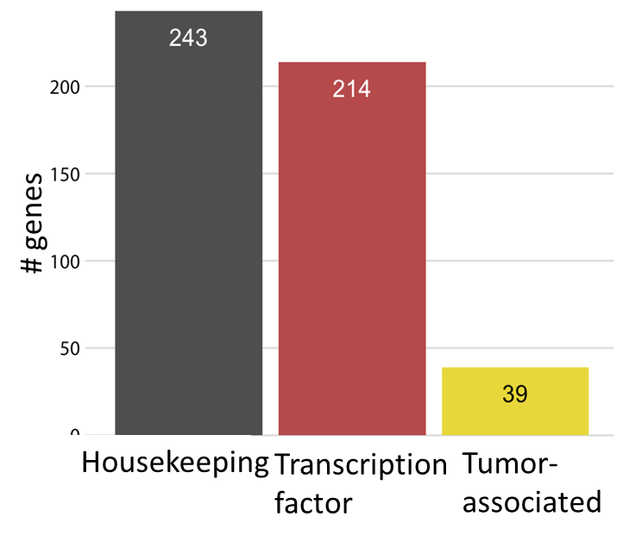
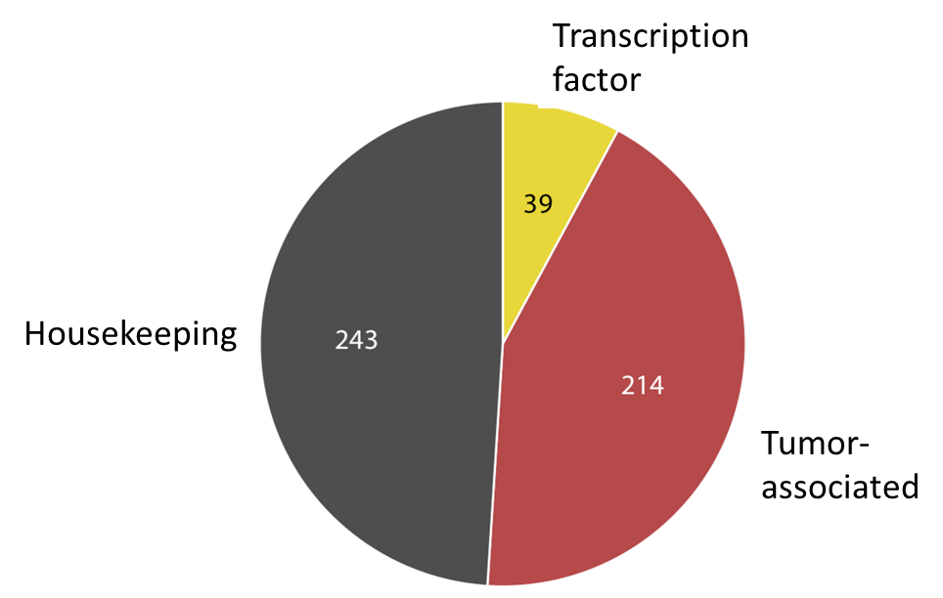
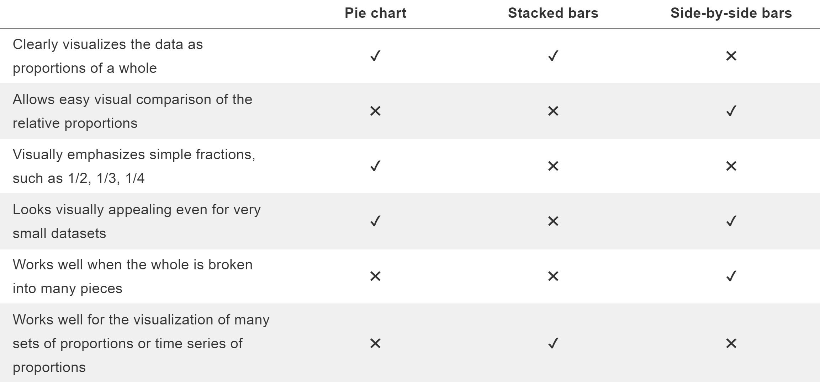
Pros and cons of the visualizing approaches for proportions
By “closing” the plots
By putting them in such a way that facilitates comparison
Using the behavior of the human visual system
Yes for pie chart, not sure for side-by-side bars
By having them all start at zero baseline
By putting multiple proportions in a bar
Adapted from Fundamentals of Data Visualization, Wilke, O’Reilly, 1st Ed.

Slide 8
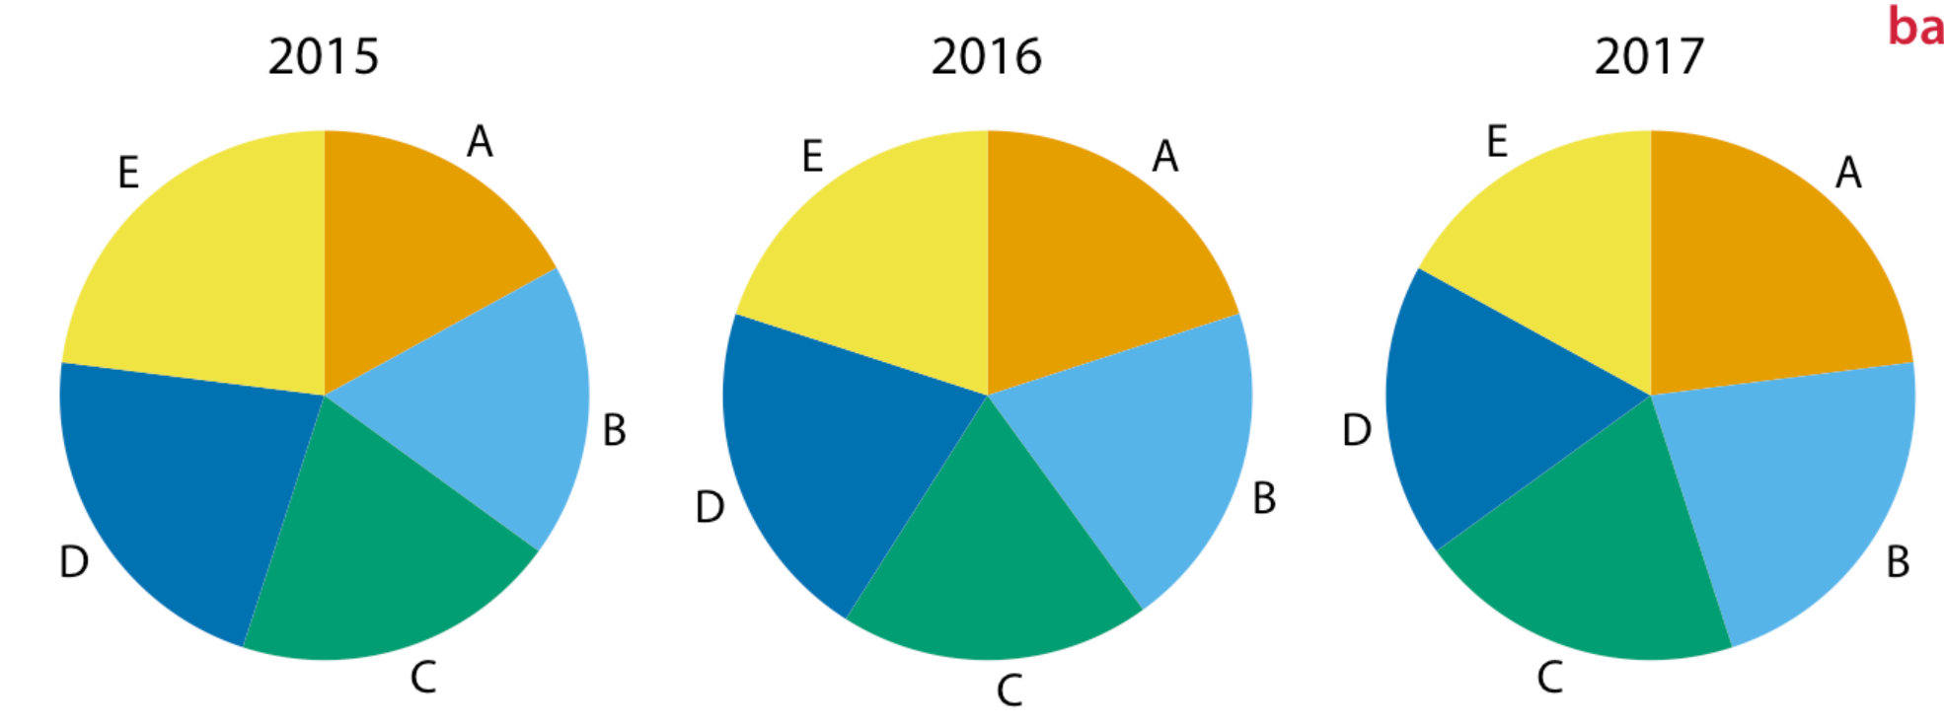
A case for side-by-side bars
Proportions of five gene groups across time points, A–E
Adapted from Fundamentals of Data Visualization, Wilke, O’Reilly, 1st Ed.
Cons: unclear for small changes
Notes:
I will now demonstrate a case where pie charts fail. Consider the hypothetical scenario of five companies, A, B, C, D, and E, who all have roughly comparable market share of approximately 20%. Our hypothetical dataset lists the market share of each company for three consecutive years. When we visualize this dataset with pie charts, it is difficult to see what exactly is going on (Figure 10.4). It appears that the market share of company A is growing and the one of company E is shrinking, but beyond this one observation we can’t tell what’s going on. In particular, it is unclear how exactly the market shares of the different companies compare within each year.

Slide 9
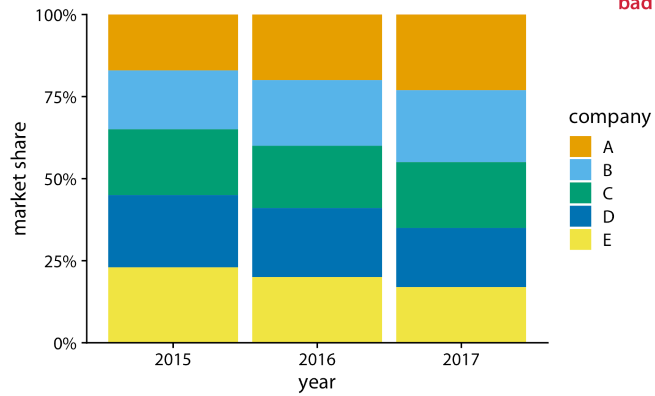
A case for side-by-side bars
Proportions of five gene groups across time points, A–E
Pros: clearer for big changes, e. g., gene group A and E
Cons:
Unclear for small changes especially placed in the middle
Difficult to compare within each year
Gene group
Adapted from Fundamentals of Data Visualization, Wilke, O’Reilly, 1st Ed.
Notes:
The picture becomes a little clearer when we switch to stacked bars (Figure 10.5). Now the trends of a growing market share for company A and a shrinking market share for company E are clearly visible. However, the relative market shares of the five companies within each year are still hard to compare. And it is difficult to compare the market shares of companies B, C, and D across years, because the bars are shifted relative to each other across years. This is a general problem of stacked-bar plots, and the main reason why I normally do not recommend this type of visualization.

Slide 10
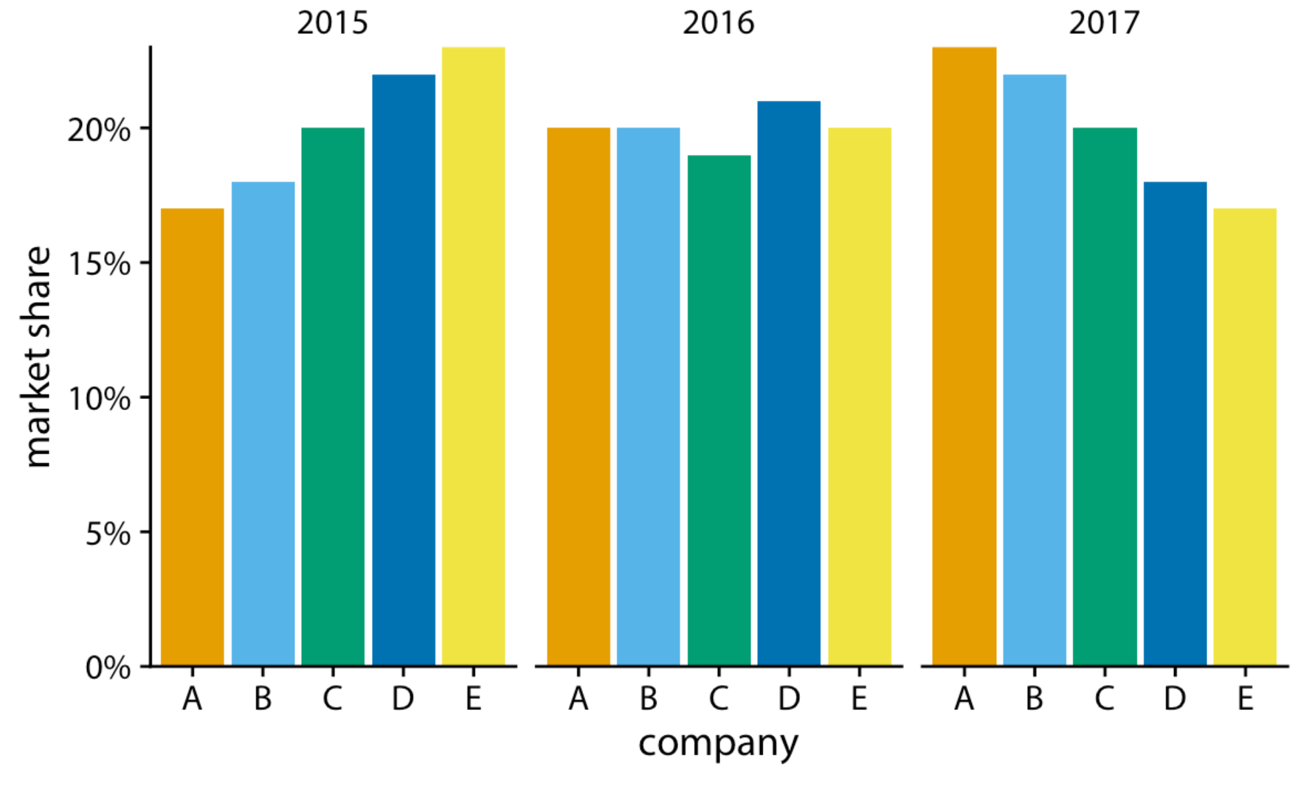
A case for side-by-side bars
Proportions of five gene groups across time points, A–E
Pros: clear for all changes regardless of their relative positions, e.g. gene group B
Cons: difficult to read if too many bars
Fundamentals of Data Visualization, Wilke, O’Reilly, 1st Ed.
Notes:
For this hypothetical data set, side-by-side bars are the best choice (Figure 10.6). This visualization highlights that both companies A and B have increased their market share from 2015 to 2017 while both companies D and E have reduced theirs. It also shows that market shares increase sequentially from company A to E in 2015 and similarly decrease in 2017.

Slide 11
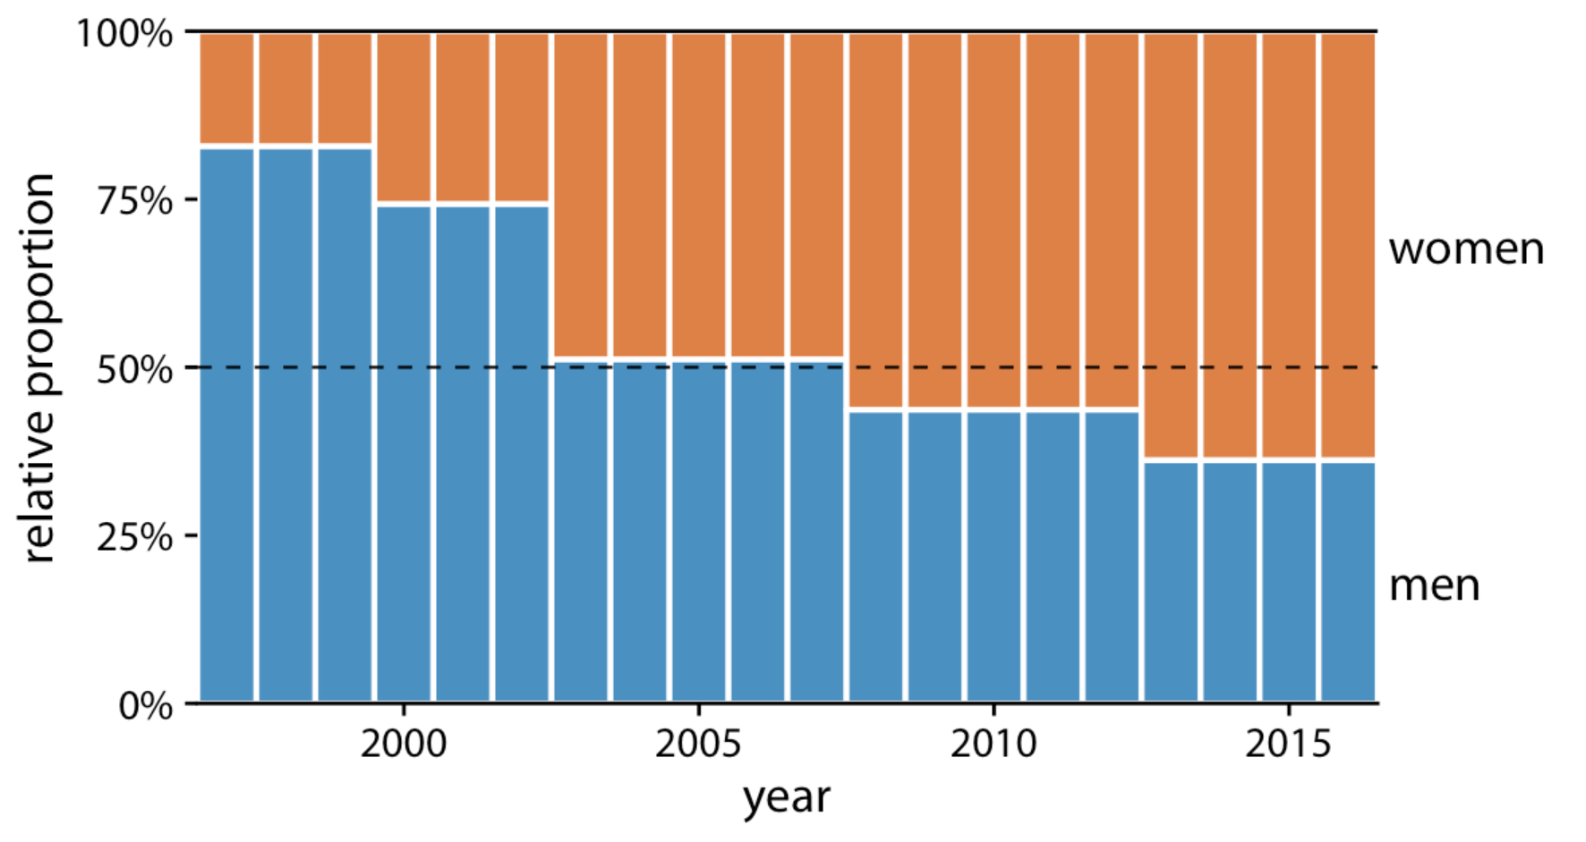
A case for stacked bars
Proportions in expressed genes over time
Pros: work well for two-group data
A good use of horizontal line at 50%
tumor-promoter
(oncogene)
tumor-suppressor
Fundamentals of Data Visualization, Wilke, O’Reilly, 1st Ed.
Notes:
In Section 10.2, I wrote that I don’t normally recommend sequences of stacked bars, because the location of the internal bars shifts along the sequence. However, the problem of shifting internal bars disappears if there are only two bars in each stack, and in those cases the resulting visualization can be quite clear. As an example, consider the proportion of women in a country’s national parliament. We will specifically look at the African country Rwanda, which as of 2016 tops the list of countries with the highest proportion of female parliament members. Rwanda has had a majority female parliament since 2008, and since 2013 nearly two-thirds of its members of parliament are female. To visualize how the proportion of women in the Rwandan parliament has changed over time, we can draw a sequence of stacked bar graphs (Figure 10.7). This figure provides an immediate visual representation of the changing proportions over time. To help the reader see exactly when the majority turned female, I have added a dashed horizontal line at 50%. Without this line, it would be near impossible to determine whether from 2003 to 2007 the majority was male or female. I have not added similar lines at 25% and 75%, to avoid making the figure too cluttered.

Slide 12
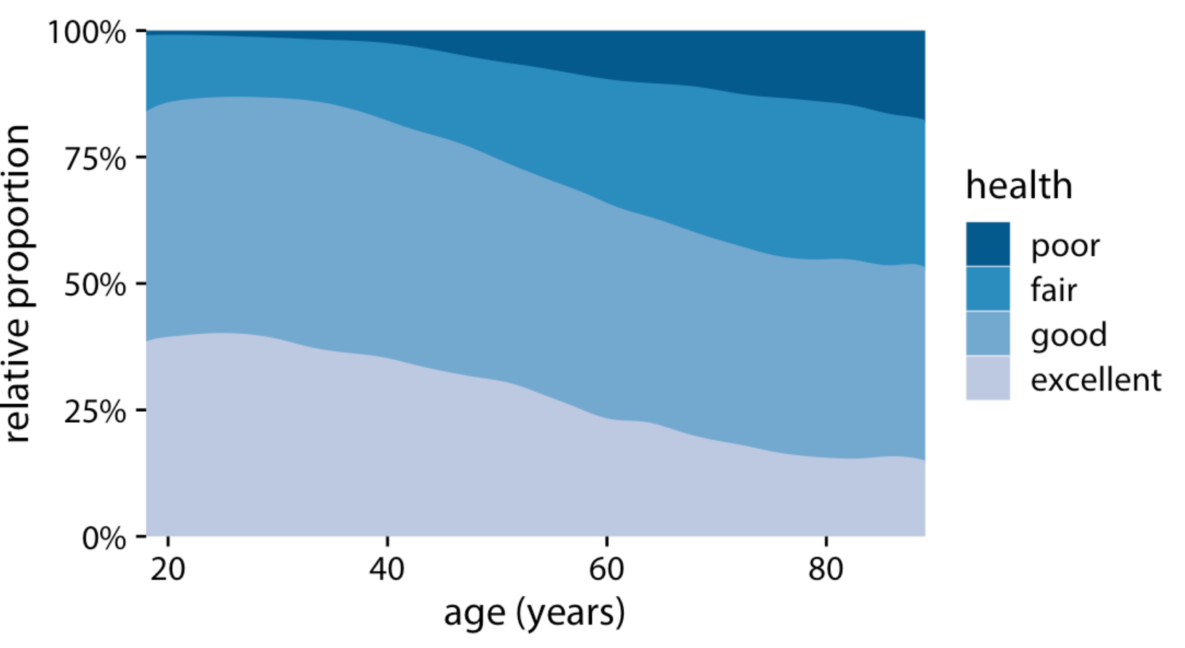
Stacked densities show how proportions change in response to a continuous variable
Cons:
The bars can’t be compared easily because of different baseline
Can’t indicate the size of different age groups, e. g., young people vs. old people
Health status by age, as reported by the general social survey (GSS)
Fundamentals of Data Visualization, Wilke, O’Reilly, 1st Ed.
Notes:
If we want to visualize how proportions change in response to a continuous variable, we can switch from stacked bars to stacked densities. Stacked densities can be thought of as the limiting case of infinitely many infinitely small stacked bars arranged side-by-side. The densities in stacked-density plots are typically obtained from kernel density estimation, as described in Chapter 7, and I refer you to that chapter for a general discussion of the strengths and weaknesses of this method.
To give an example where stacked densities may be appropriate, consider the health status of people as a function of age. Age can be considered a continuous variable, and visualizing the data in this way works reasonably well (Figure 10.8). Even though we have four health categories here, and I’m generally not a fan of stacking multiple conditions, as discussed above, I think in this case the figure is acceptable. We can see clearly that overall health declines as people age, and we can also see that despite this trend, over half of the population remain in good or excellent health until very old age.
Nevertheless, this figure has a major limitation: By visualizing the proportions of the four health conditions as percent of the total, the figure obscures that there are many more young people than old people in the dataset. Thus, even though the percentage of people reporting to be in good health remains approximately unchanged across ages spanning seven decades, the absolute number of people in good health declines as the total number of people at a given age declines. I will present a potential solution to this problem in the next section.

Slide 13
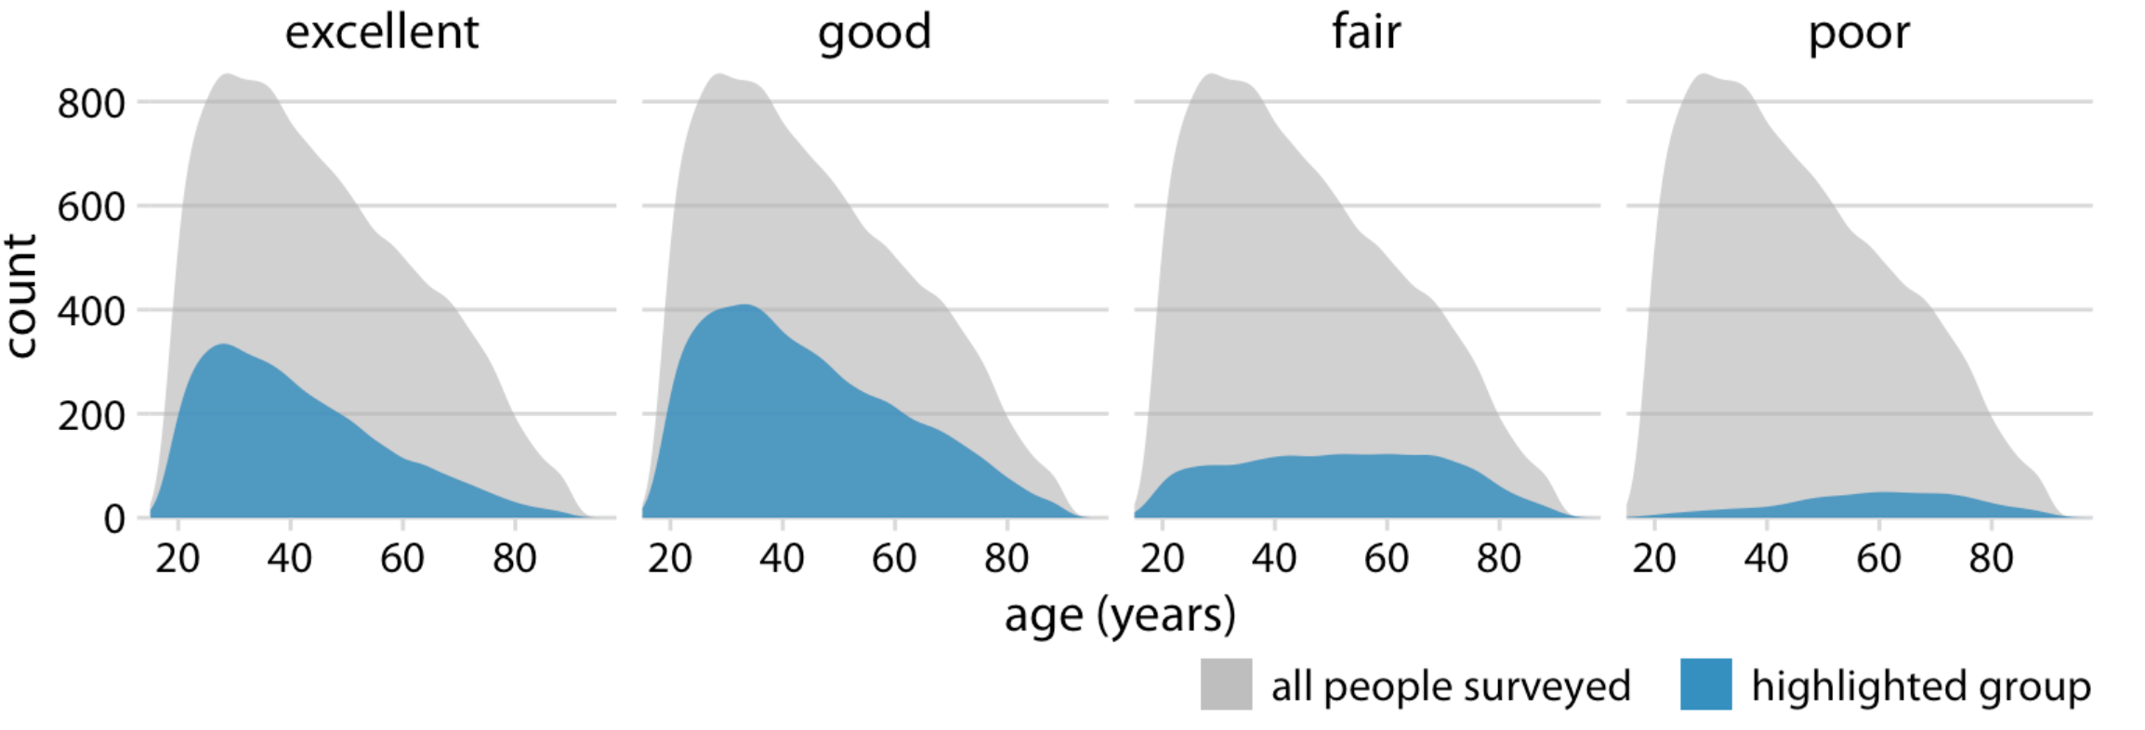
Side-by-side stacked densities showing numbers as parts of the total
Health status by age, as reported by the general social survey (GSS)
Solution:
Making a separate plot for each category
Plotting the size of different age groups
Fundamentals of Data Visualization, Wilke, O’Reilly, 1st Ed.
Notes:
Side-by-side bars have the problem that they don’t clearly visualize the size of the individual parts relative to the whole and stacked bars have the problem that the different bars cannot be compared easily because they have different baselines. We can resolve these two issues by making a separate plot for each part and in each plot showing the respective part relative to the whole. For the health dataset of Figure 10.8, this procedure results in Figure 10.9. The overall age distribution in the dataset is shown as the shaded gray areas, and the age distributions for each health status are shown in blue. This figure highlights that in absolute terms, the number people with excellent or good health declines past ages 30–40, while the number of people with fair health remains approximately constant across all ages.

Slide 14
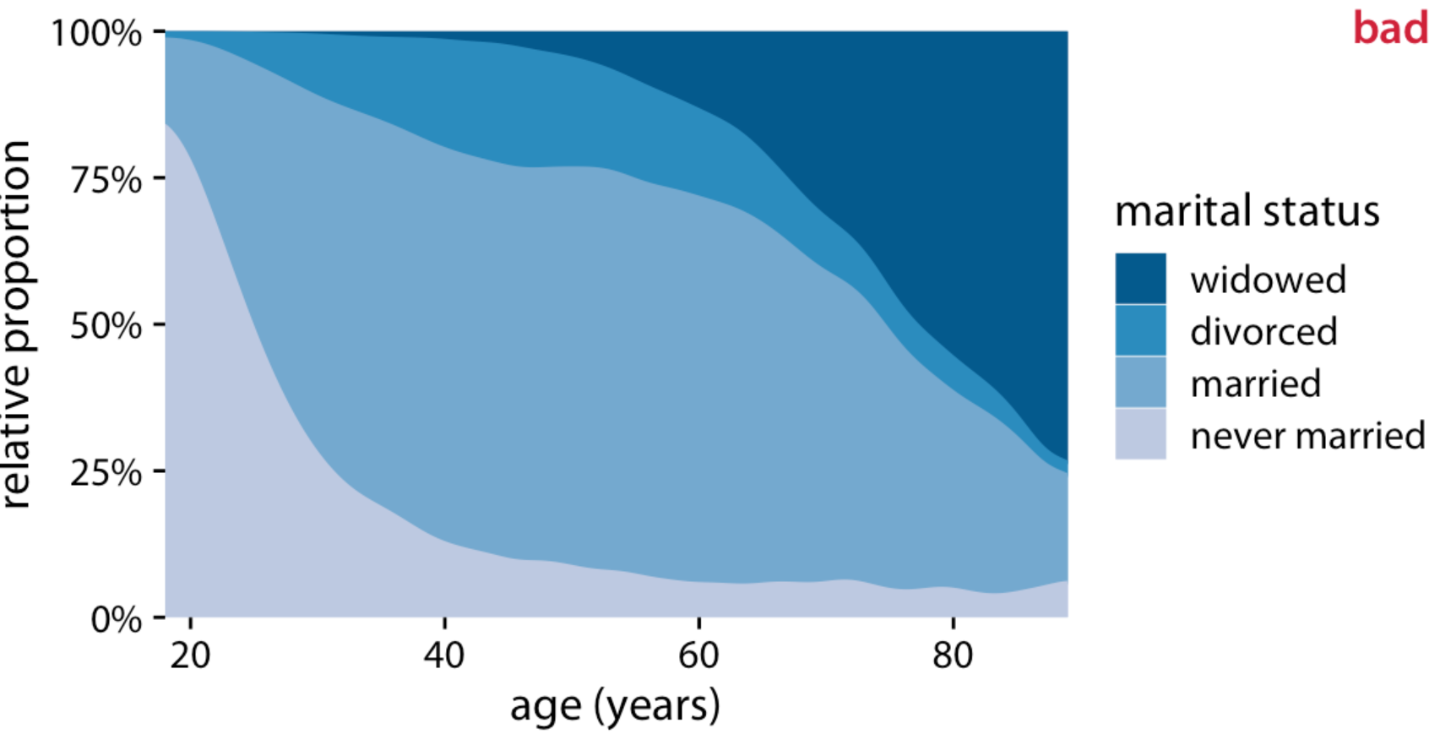
Stacked densities overwhelmed by prevailing signals
Marital status by age, as reported by the general social survey (GSS)
e. g., drastic changes in widowed and never married distort for divorced and married
Fundamentals of Data Visualization, Wilke, O’Reilly, 1st Ed.
Notes:
To provide a second example, let’s consider a different variable from the same survey: marital status. Marital status changes much more drastically with age than does health status, and a stacked densities plot of marital status vs age is not very illuminating.
I have labeled this figure as “bad” because the frequency of people who have never been married or are widowed changes so drastically with age that the age distributions of married and divorced people are highly distorted and difficult to interpret.

Slide 15
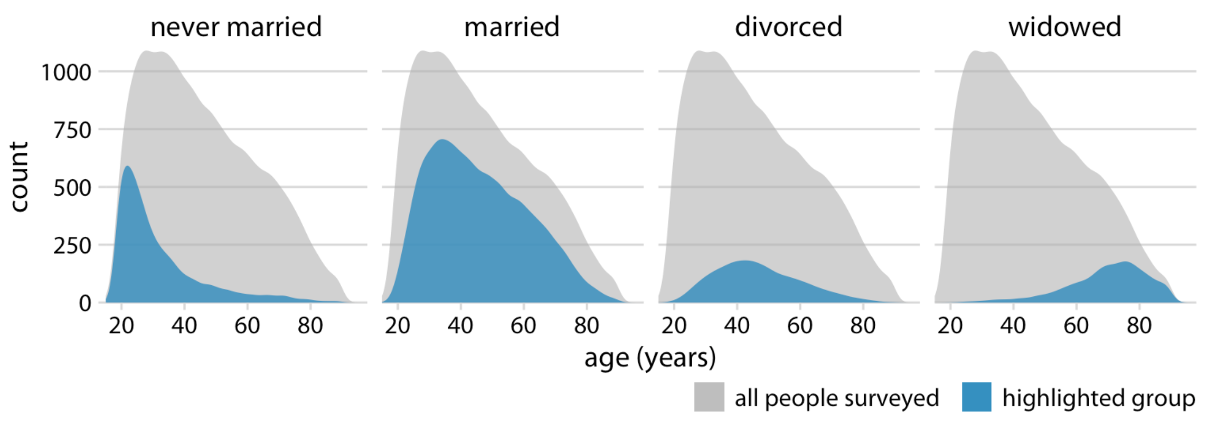
Side-by-side stacked densities showing numbers as parts of the total
Marital status by age, as reported by the general social survey (GSS)
Pros: easily see the patterns (e. g., peaks) without getting distorted by other populations
What if we’re interested in determining relative proportions, e. g., at what age > 50% of people married?
Fundamentals of Data Visualization, Wilke, O’Reilly, 1st Ed.
Notes:
The same dataset visualized as partial densities is much clearer (Figure 10.11). In particular, we see that the proportion of married people peaks around the late 30s, the proportion of divorced people peaks around the early 40s, and the proportion of widowed people peaks around the mid 70s.
However, one downside of Figure 10.11 is that this representation doesn’t make it easy to determine relative proportions at any given point in time. For example, if we wanted to know at what age more than 50% of all people surveyed are married, we could not easily tell from Figure 10.11. To answer this question, we can instead use the same type of display but show relative proportions instead of absolute counts along the y axis (Figure 10.12). Now we see that married people are in the majority starting in their late 20s, and widowed people are in the majority starting in their mid 70s.

Slide 16
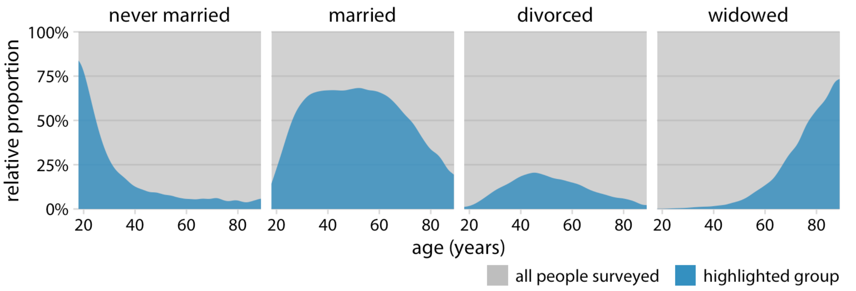
Proportions separately as parts of the total
Marital status by age, as reported by the general social survey (GSS)
Fundamentals of Data Visualization, Wilke, O’Reilly, 1st Ed.
Notes:
However, one downside of Figure 10.11 is that this representation doesn’t make it easy to determine relative proportions at any given point in time. For example, if we wanted to know at what age more than 50% of all people surveyed are married, we could not easily tell from Figure 10.11. To answer this question, we can instead use the same type of display but show relative proportions instead of absolute counts along the y axis (Figure 10.12). Now we see that married people are in the majority starting in their late 20s, and widowed people are in the majority starting in their mid 70s.

Slide 17
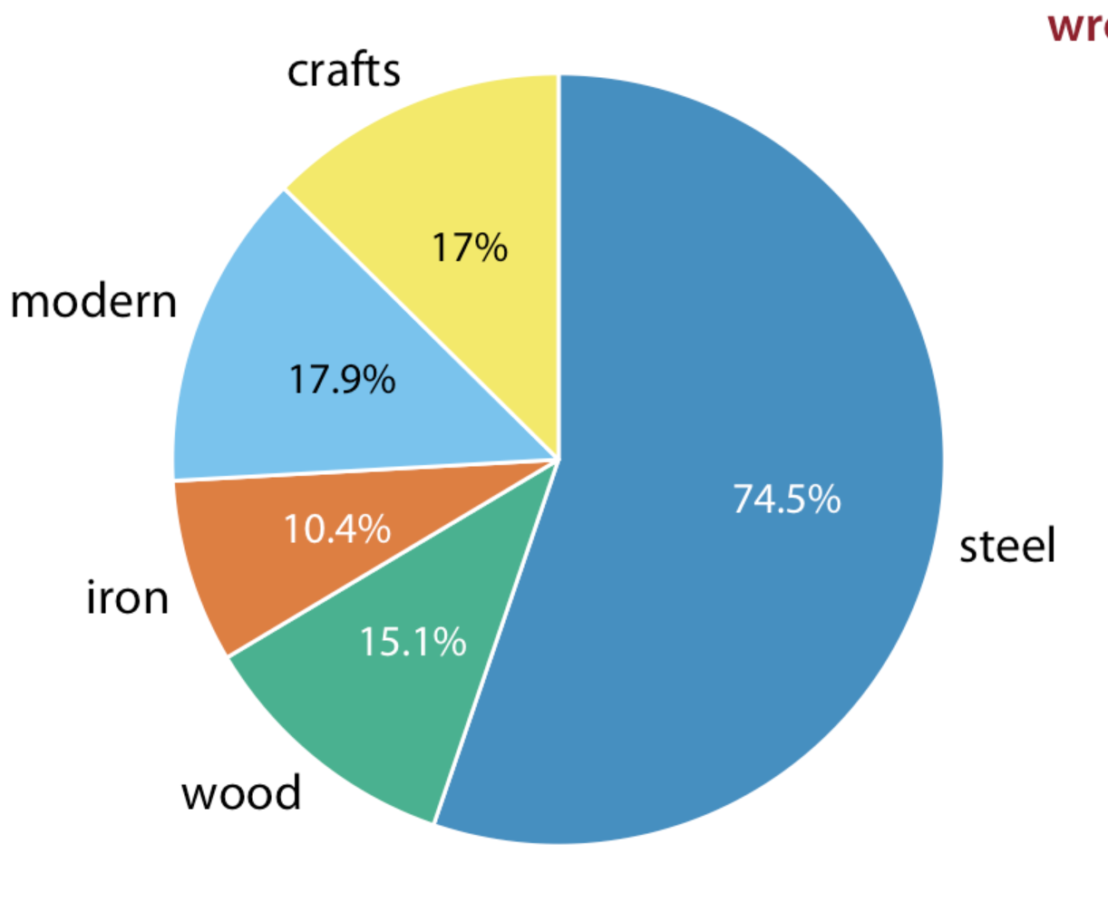
Nested proportions in pie chart to show proportions in two categorical variables
106 bridges in Pittsburgh
Nested proportions for two categories : e. g.,
Health and martial status or
Genes up- or down-regulated (case vs. control) and whether tumor suppressors or tumor promoters
Bridges by construction material (steel, wood, iron) and by date of construction (crafts, before 1870, and modern, after 1940)
Fundamentals of Data Visualization, Wilke, O’Reilly, 1st Ed.
Notes:
In the preceding chapter, I discussed scenarios where a dataset is broken into pieces defined by one cateogical variable, such as political party, company, or health status. It is not uncommon, however, that we want to drill down further and break down a dataset by multiple categorical variables at once. For example, in the case of parliamentary seats, we could be interested in the proportions of seats by party and by the gender of the representatives. Similarly, in the case of people’s health status, we could ask how health status further breaks down by marital status. I refer to these scenarios as nested proportions, because each additional categorical variable that we add creates a finer subdivision of the data nested within the previous proportions. There are several suitable approaches to visualize such nested proportions, including mosaic plots, treemaps, and parallel sets.
I will begin by demonstrating two flawed approaches to visualizing nested proportions. While these approaches may seem nonsensical to any experienced data scientist, I have seen them in the wild and therefore think they warrant discussion. Throughout this chapter, I will work with a dataset of 106 bridges in Pittsburgh. This dataset contains various pieces of information about the bridges, such as the material from which they are constructed (steel, iron, or wood) and the year when they were erected. Based on the year of erection, bridges are grouped into distinct categories, such as crafts bridges that were erected before 1870 and modern bridges that were erected after 1940.
Let’s assume we want to visualize both the fraction of bridges made from steel, iron, or wood and the fraction that are crafts or modern. We might be tempted to do so by drawing a combined pie chart (Figure 11.1). However, this visualization is not valid. All the slices in a pie chart must add up to 100%, and here the slices add up to 135%. We reach a total percentage in excess of 100% because we are double-counting bridges. Every bridge in the dataset is made of steel, iron, or wood, so these three slices of the pie already represent 100% of the bridges. Every crafts or modern bridge is also a steel, iron, or wood bridge, and hence is counted twice in the pie chart.

Slide 18
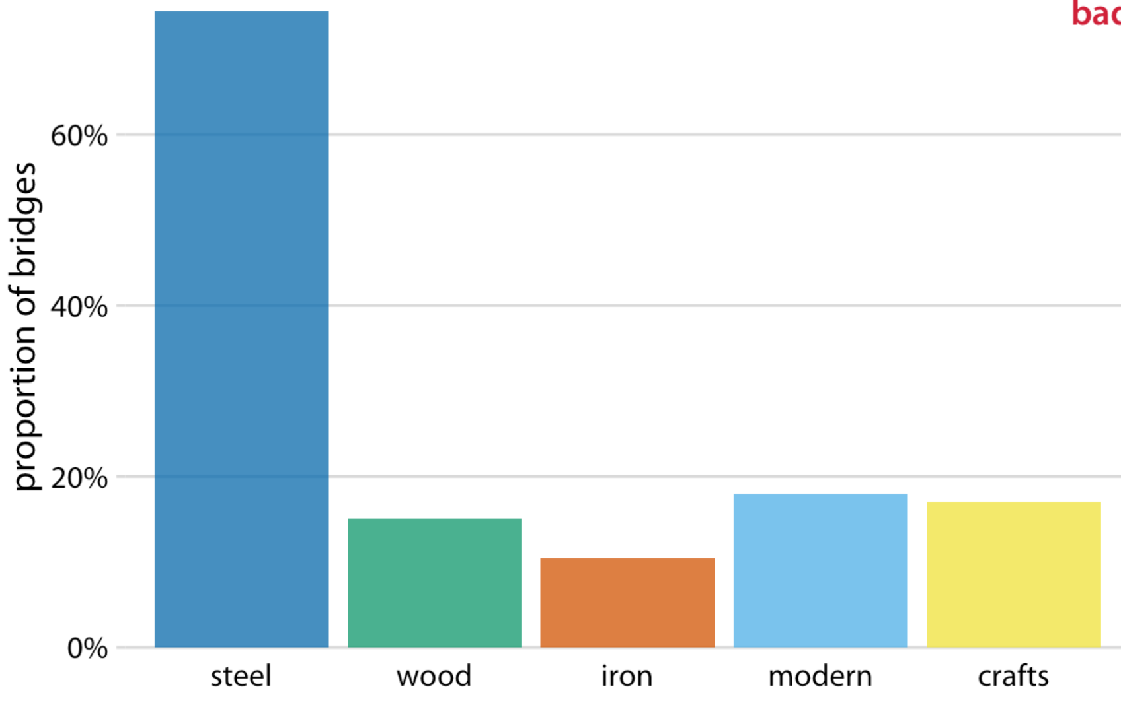
Nested proportions in pie chart to show proportions in two categorical variables
106 bridges in Pittsburgh
What’s shown: by construction material (steel, wood, iron) and by date of construction (crafts, before 1870, and modern, after 1940)
It’s OK they don’t add up to 100 (%) (?)
Fundamentals of Data Visualization, Wilke, O’Reilly, 1st Ed.
Notes:
Double-counting is not necessarily a problem if we choose a visualization that does not require the proportions to add to 100%. As discussed in the preceding chapter, side-by-side bars meet this criterion. We can show the various proportions of bridges as bars in a single plot, and this plot is not technically wrong (Figure 11.2). Nevertheless, I have labeled it as “bad”, because it does not immediately show that there is overlap among some of the categories shown. A casual observer might conclude from Figure 11.2 that there are five separate categories of bridges, and that, for example, modern bridges are neither made of steel nor of wood or iron.

Slide 19
Nested proportions in pie chart to show proportions in two categorical variables
106 bridges in Pittsburgh
E. g., by construction material (steel, wood, iron) and by date of construction (crafts, before 1870, and modern, after 1940)
It’s OK they don’t add up to 100 (%)
Better to indicate the separation
Construction material
Era of construction
Fundamentals of Data Visualization, Wilke, O’Reilly, 1st Ed.
Notes:
Double-counting is not necessarily a problem if we choose a visualization that does not require the proportions to add to 100%. As discussed in the preceding chapter, side-by-side bars meet this criterion. We can show the various proportions of bridges as bars in a single plot, and this plot is not technically wrong (Figure 11.2). Nevertheless, I have labeled it as “bad”, because it does not immediately show that there is overlap among some of the categories shown. A casual observer might conclude from Figure 11.2 that there are five separate categories of bridges, and that, for example, modern bridges are neither made of steel nor of wood or iron.

Slide 20
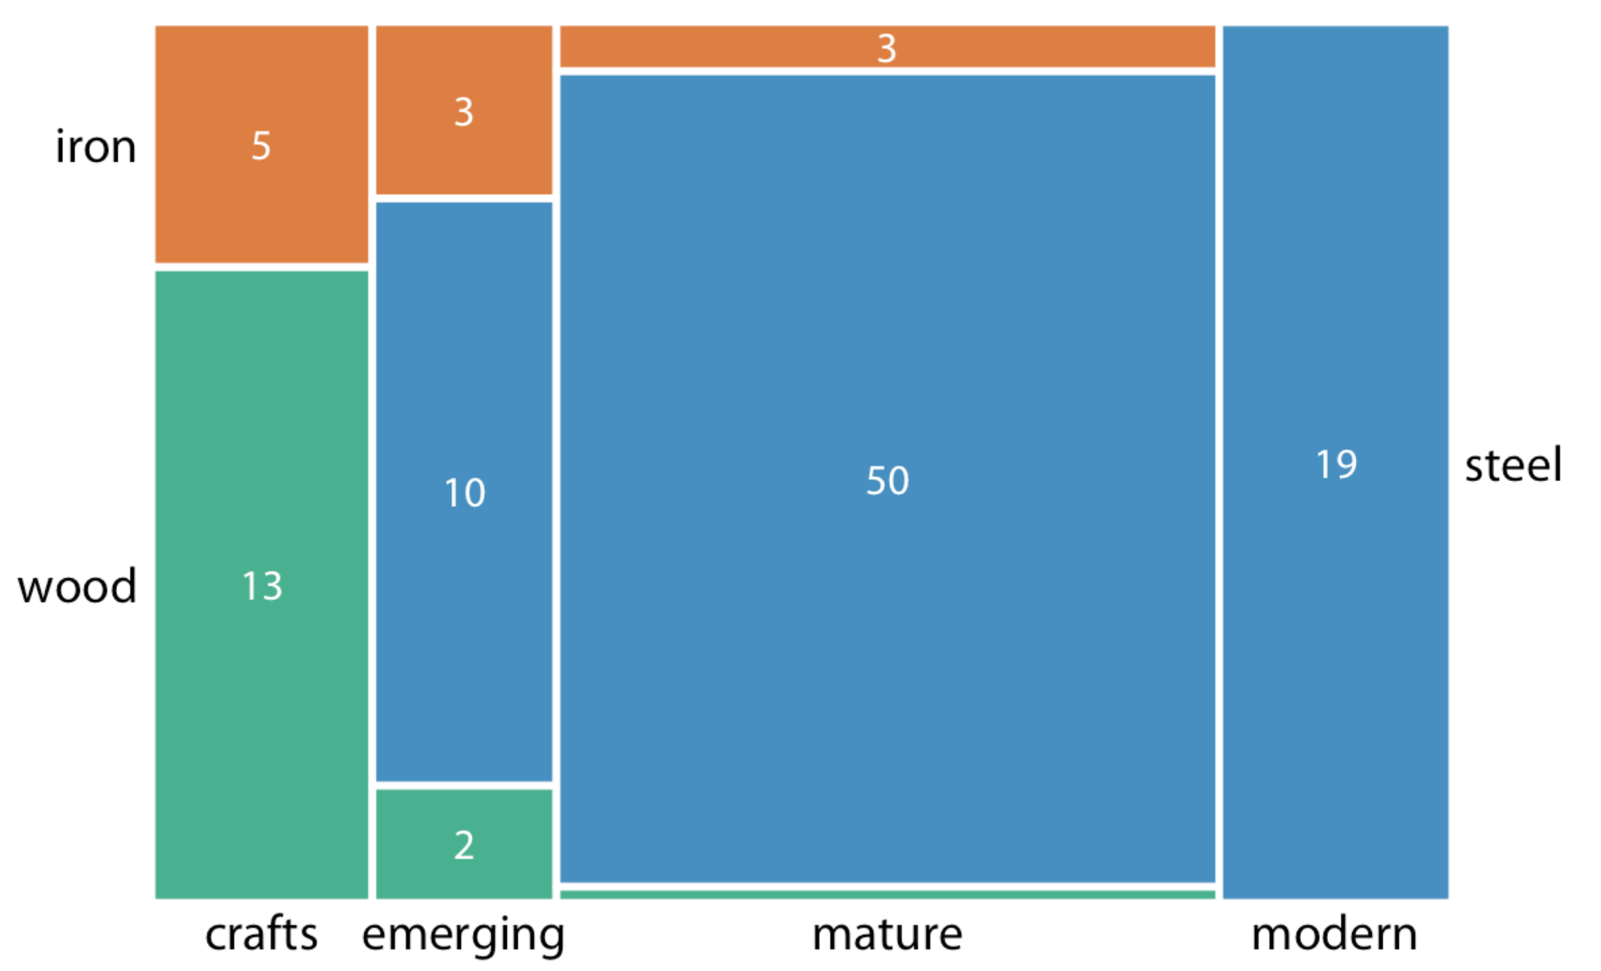
Nested proportions in mosaic plot
106 bridges in Pittsburgh
Like stacked barplots: bar heights relative proportions of the y variable
Unlike stacked barplots: bar width relative proportion of the x variable
Resulting in the rectangles proportional to the number of cases for each combination
Fundamentals of Data Visualization, Wilke, O’Reilly, 1st Ed.
Notes:
To draw a mosaic plot, we begin by placing one categorical variable along the x axis (here, era of bridge construction) and subdivide the x axis by the relative proportions that make up the categories. We then place the other categorical variable along the y axis (here, building material) and, within each category along the x axis, subdivide the y axis by the relative proportions that make up the categories of the y variable. The result is a set of rectangles whose areas are proportional to the number of cases representing each possible combination of the two categorical variables.

Slide 21
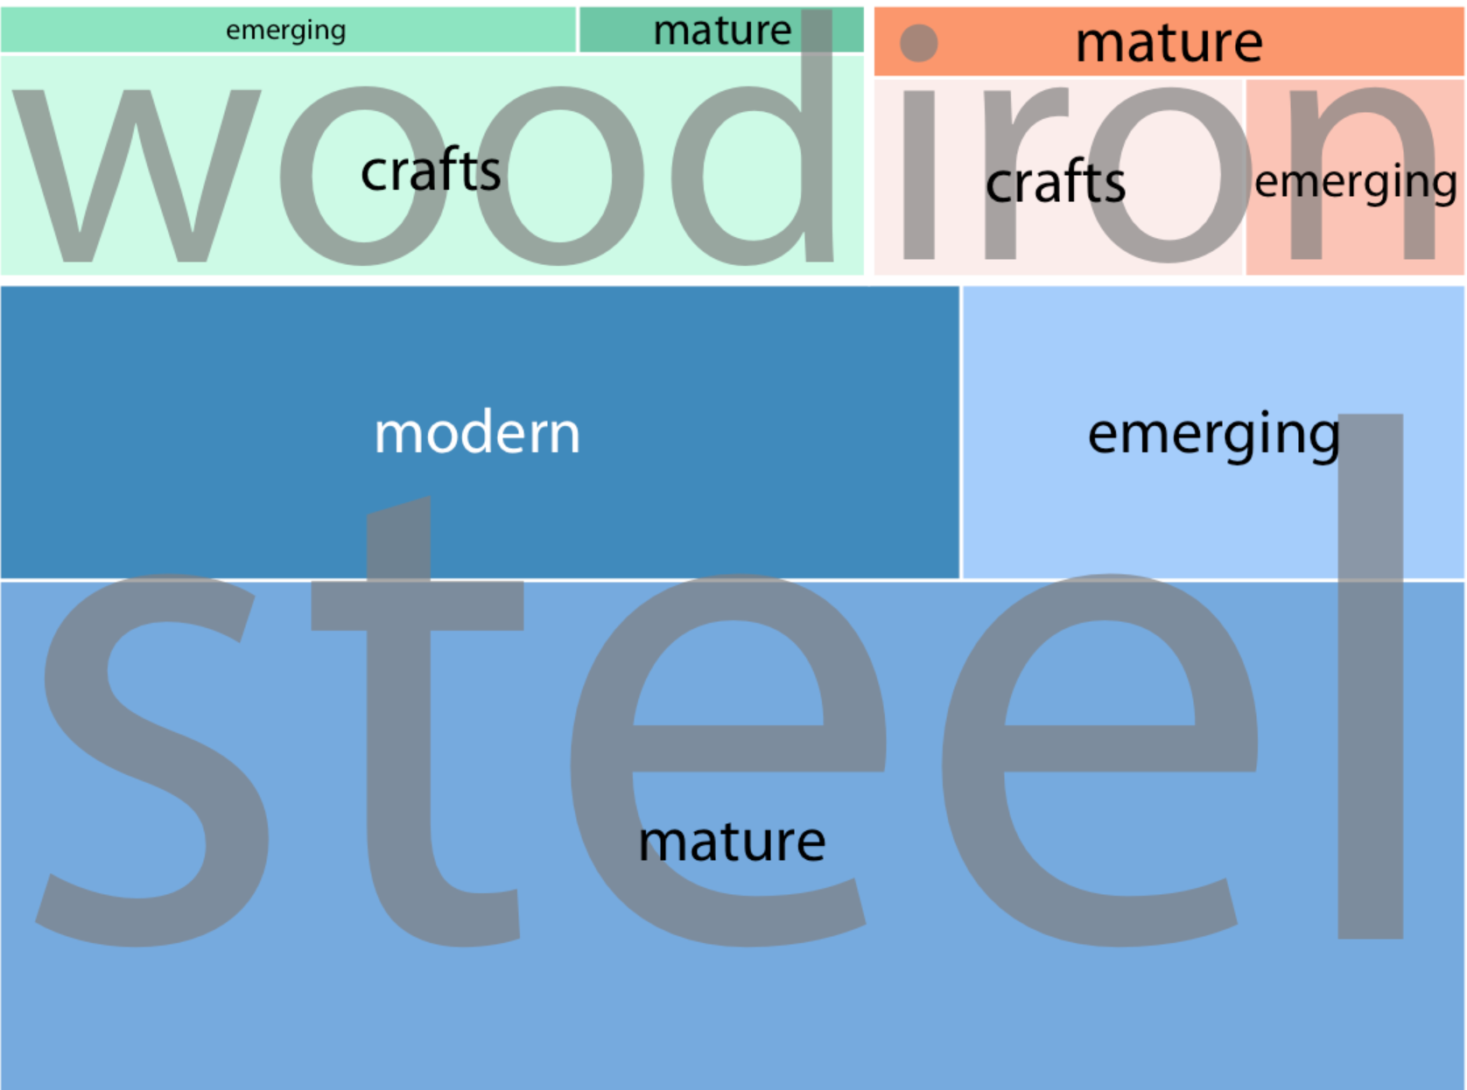
Nested proportions in treemap
106 bridges in Pittsburgh
Like mosaic plot: subdividing enclosing rectangles into smaller areas to represent the proportions
Unlike mosaic plot: recursively nest rectangles inside each other
Fundamentals of Data Visualization, Wilke, O’Reilly, 1st Ed.
Notes:
The bridges dataset can also be visualized in a related but distinct format called a treemap. In a treemap, just as is the case in a mosaic plot, we take an enclosing rectangle and subdivide it into smaller rectangles whose areas represent the proportions. However, the method of placing the smaller rectangles into the larger one is different compared to the mosaic plot. In a treemap, we recursively nest rectangles inside each other. For example, in the case of the Pittsburgh bridges, we can first subdivide the total area into three parts representing the three building materials wood, iron, and steel. Then, we subdivide each of those areas further to represent the construction eras represented for each building material (Figure 11.4). In principle, we could keep going with nesting ever more smaller subdivisions inside each other, though relatively quickly the result would become unwieldy or confusing.

Slide 22
Mosaic plot vs. treemap
Fundamentals of Data Visualization, Wilke, O’Reilly, 1st Ed.
Mosaic plots assume that the orthogonal variables identify all of the proportions
Treemaps do not require that
Notes:
To draw a mosaic plot, we begin by placing one categorical variable along the x axis (here, era of bridge construction) and subdivide the x axis by the relative proportions that make up the categories. We then place the other categorical variable along the y axis (here, building material) and, within each category along the x axis, subdivide the y axis by the relative proportions that make up the categories of the y variable. The result is a set of rectangles whose areas are proportional to the number of cases representing each possible combination of the two categorical variables.

Slide 23
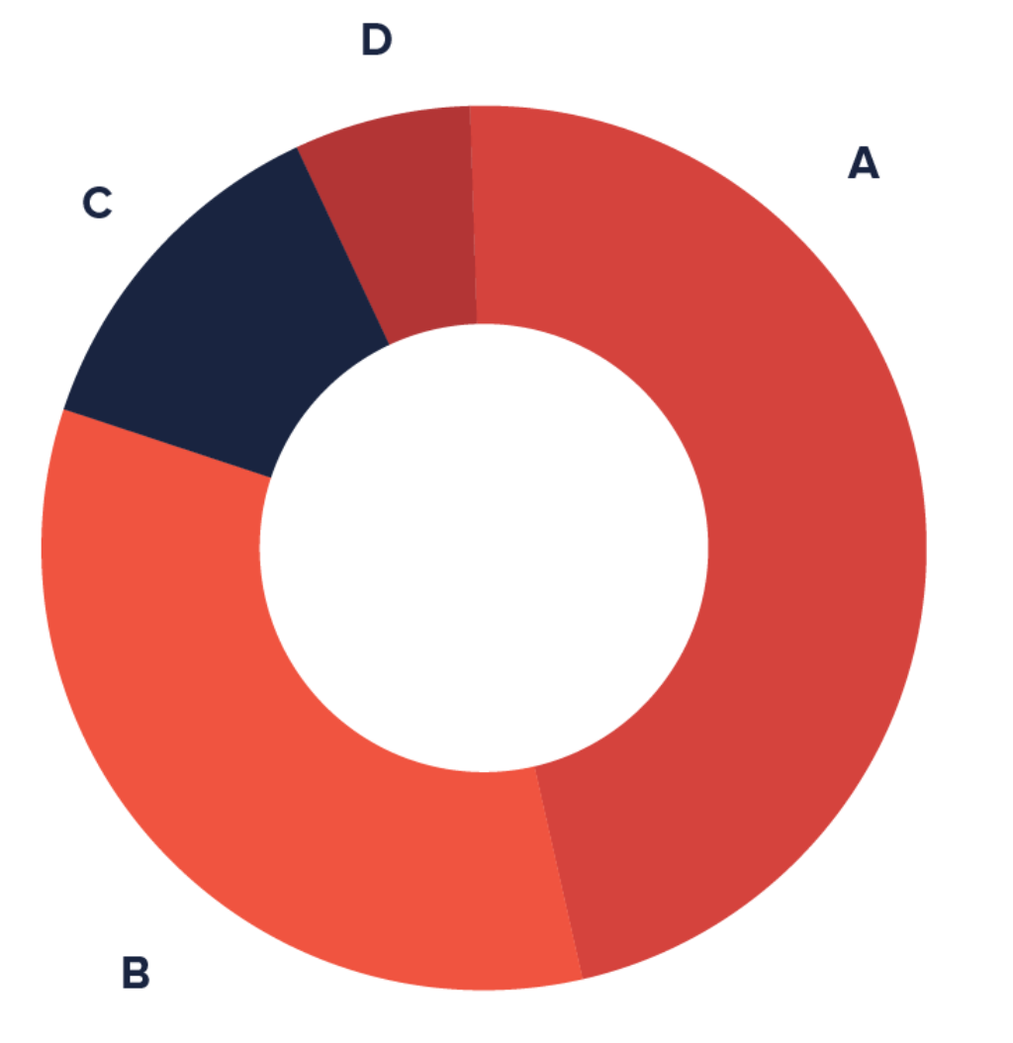
Donut chart equivalent to piechart
Identical function to a pie chart
Provide a better data intensity ratio because of the blank center?
https://datavizproject.com/
Notes:
since the blank center can be used to display additional, related data.

Slide 24
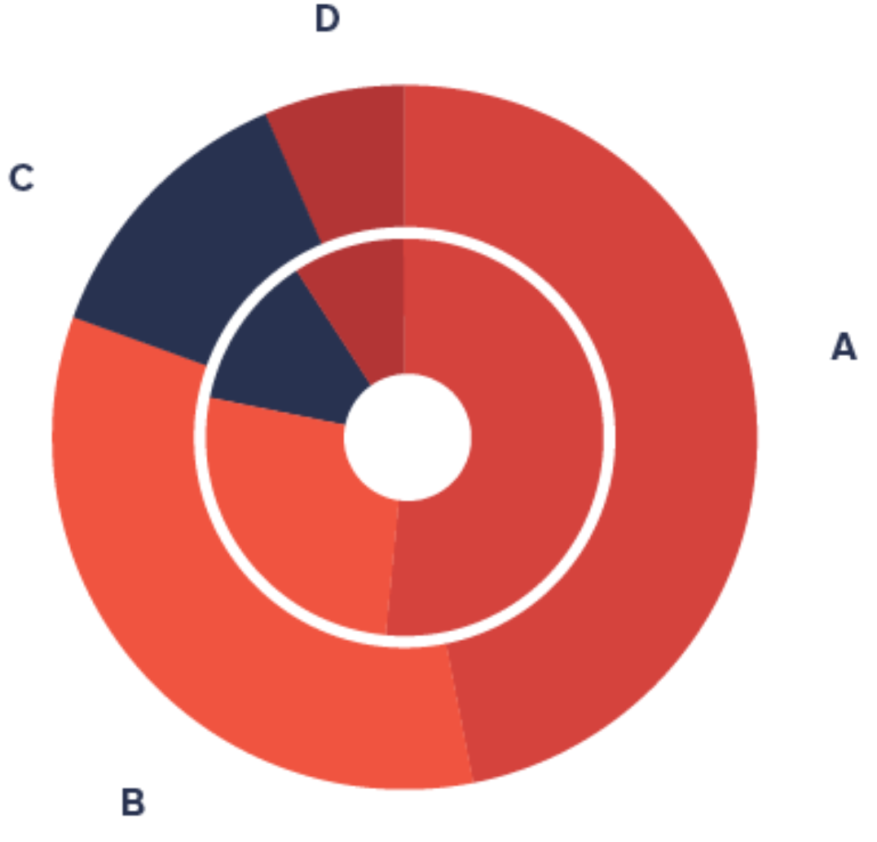
Multi-layer donut chart for multiple proportion
Concentric circles each representing proportion
Good for comparing across the circles?
Other limitations?
https://datavizproject.com/

Slide 25
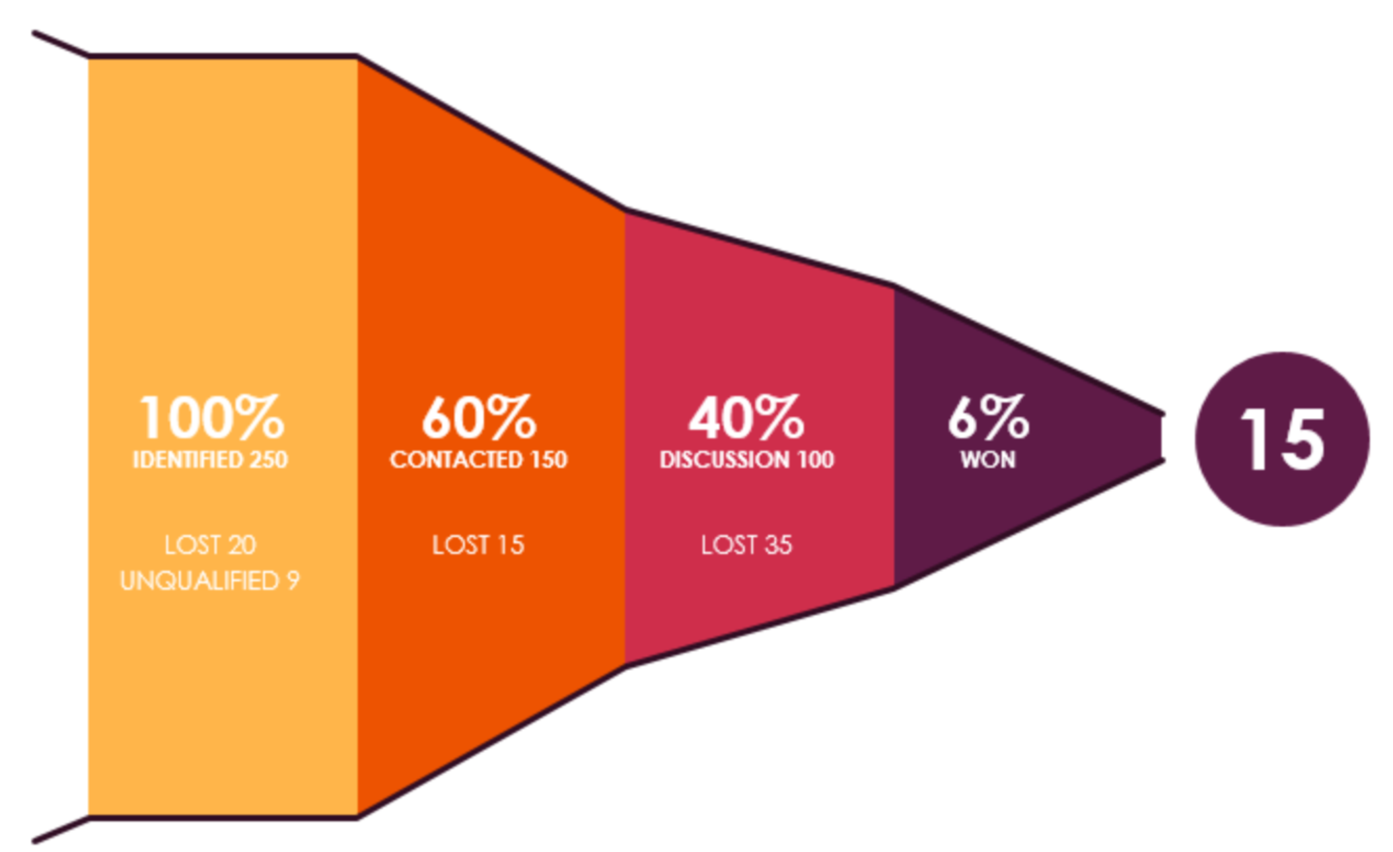
Funnel chart for show proportion during a process
Each slice represents a process filtering out data
https://exceldashboardschool.com/sales-funnel-chart/
Notes:
This is good to track down the data going through each filter.
This example figure shows 250 items identified

Slide 26
Enrichment can be estimated by overlap
Is your gene set enriched in a predefined gene set, e. g., apoptosis?
Does your gene set overlap with the gene set?
How enriched is your gene set in the gene set?
How significant is the overlap?
Note that enrichment can consider more than overlap to make more informative decisions
(e.g., gene set enrichment analysis, GSEA)
Notes:
Need to explain the group annotation and the number in each set
The size of the circle should correspond to the set size

Slide 27
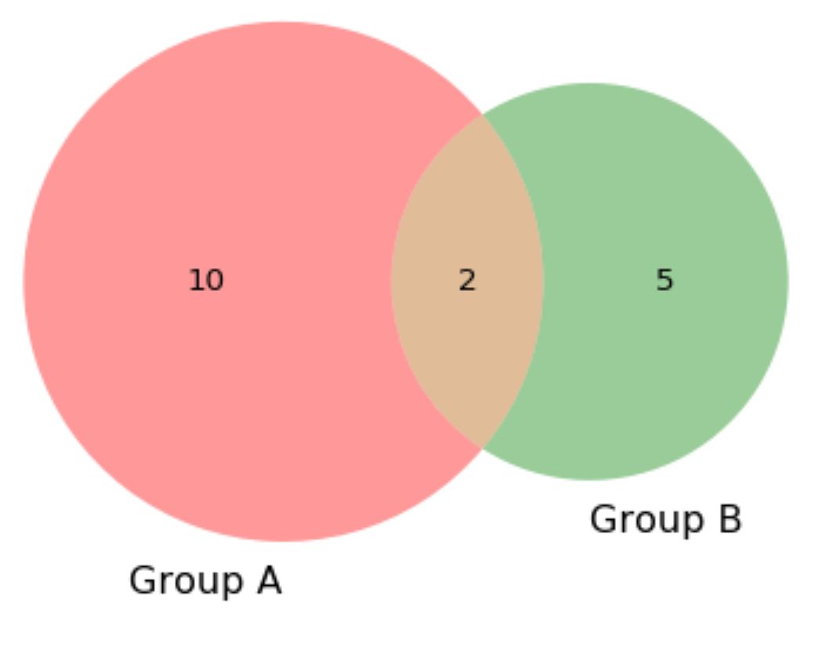
Enrichment often presented by overlap
Venn diagram to show enrichment
Input gene set
Reference gene set
Notes:
Need to explain the group annotation and the number in each set
The size of the circle should correspond to the set size

Slide 28
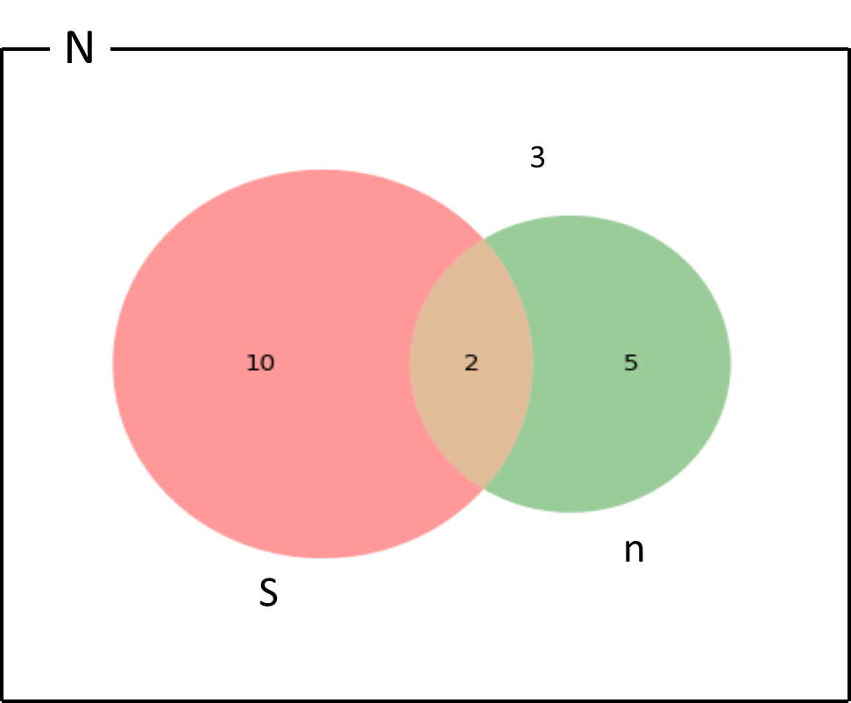
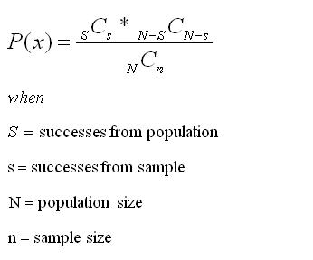
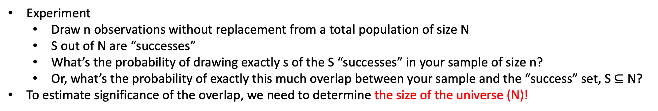
Hypergeometric test to estimate significance of overlap
s
s
Experiment
Draw n observations without replacement from a total population of size N
S out of N are “successes”
What’s the probability of drawing exactly s of the S “successes” in your sample of size n?
Or, what’s the probability of exactly this much overlap between your sample and the “success” set, S $⊆$ N?
To estimate significance of the overlap, we need to determine the size of the universe (N)!
Notes:
This illustration can be mathematically formulated as follows.

Slide 29
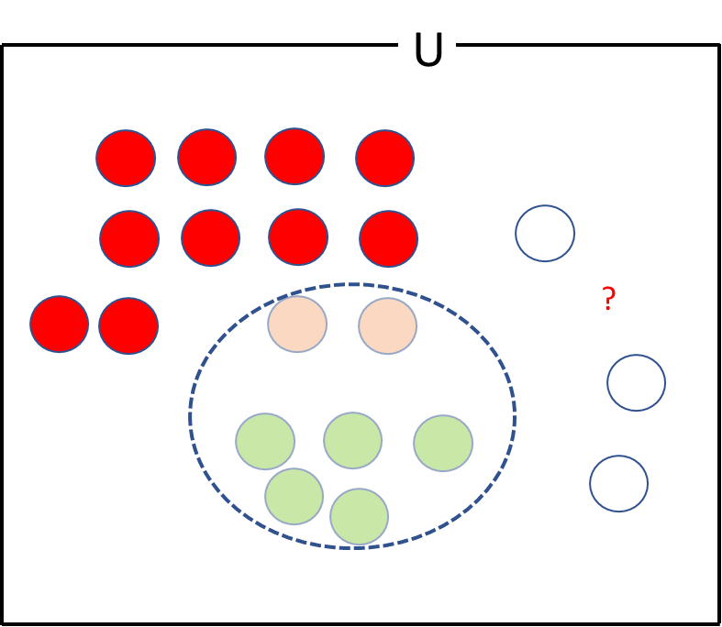
Hypergeometric test to estimate significance of overlap
U
3
To estimate significance of the overlap, we need to determine the size of the “universe”
You can play with the size of the universe to make a favorable significance
Notes:
To estimate statistical significance, we first need to make sure to have the universe set.
Once it is set, we can perform hypergeometric test.
To understand hypergeometric test, let’s think of the universe set as an urn or a container.
In the urn, there are 12 organe balls and 10 white balls.
Let’s shake the urn and take 7 blindfolded.
Let’s say you get 2 organe and 5 white balls.

Slide 30
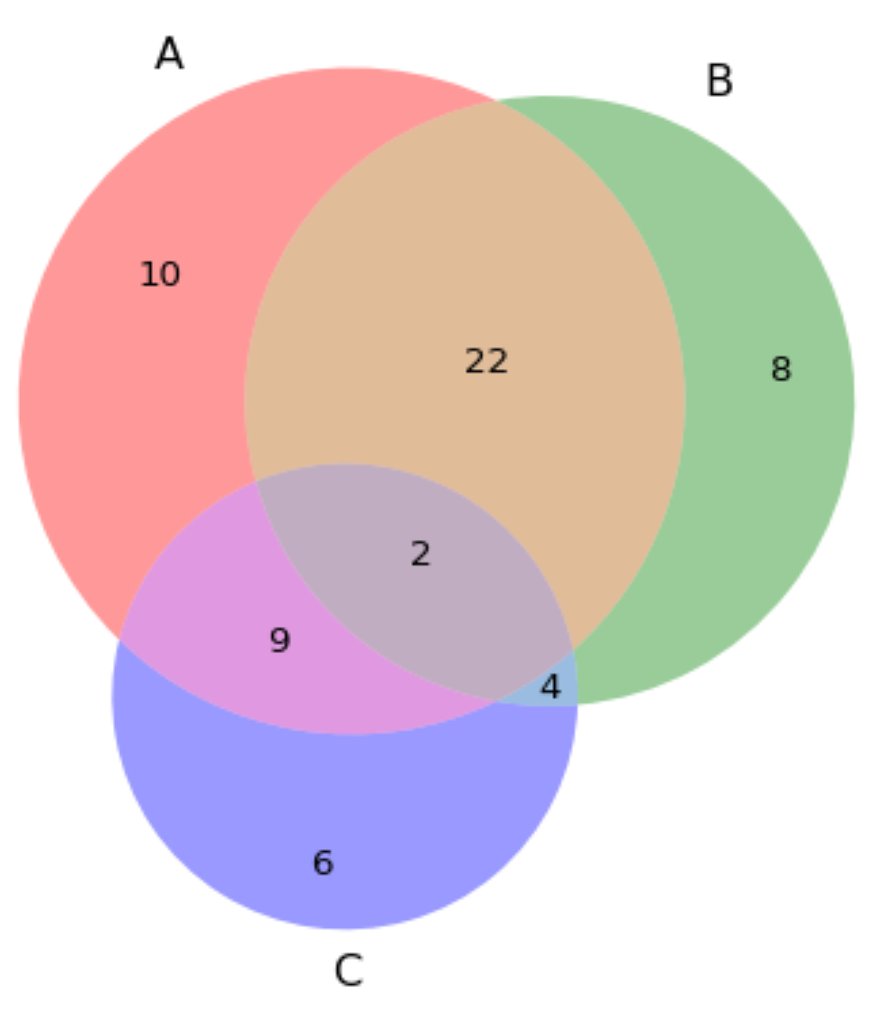
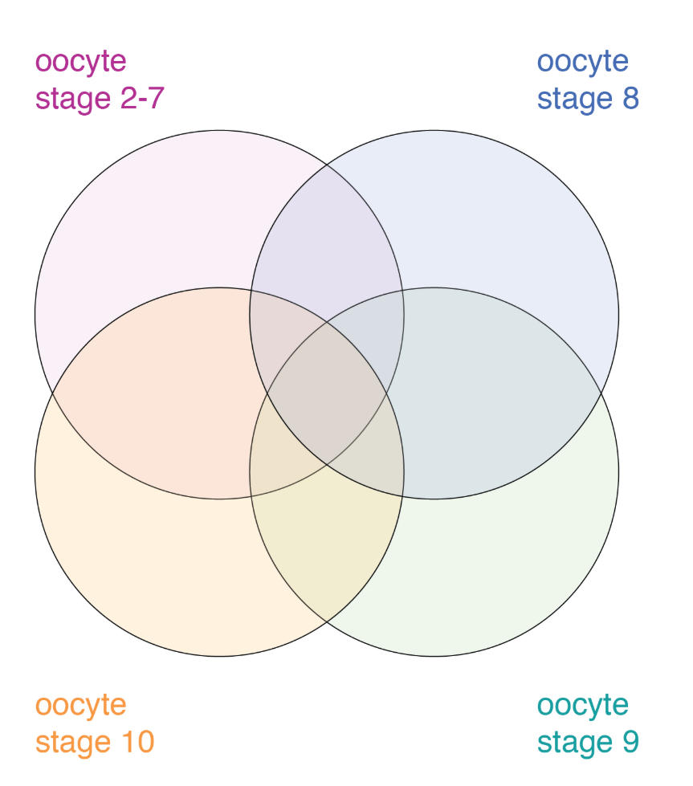
Venn diagram to show overlap for 3 or fewer sets
Difficult to focus
Not OK to show an interesting subset of overlaps
Encouraged to use only for exploration
What’s “wrong” with the figure on the right?
Notes:
Of course, we can visualize overlap of three sets in the same fashion.
The change is that we need to visualize 4 overlaps or set intersections.
Although it is a bit distracting or out of focus, it might be OK to present this if it comes with text describing what you want to show.

Slide 31
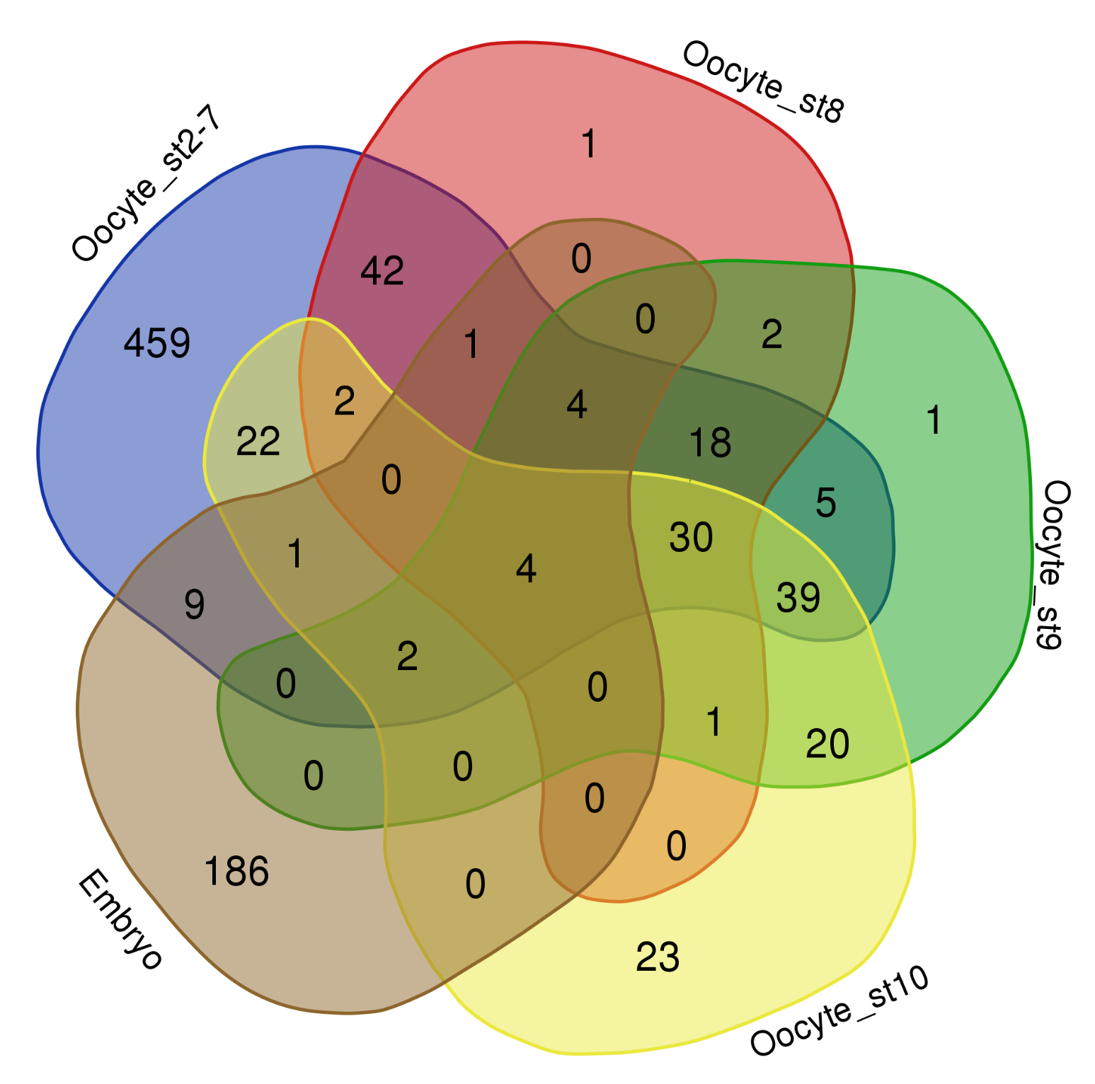
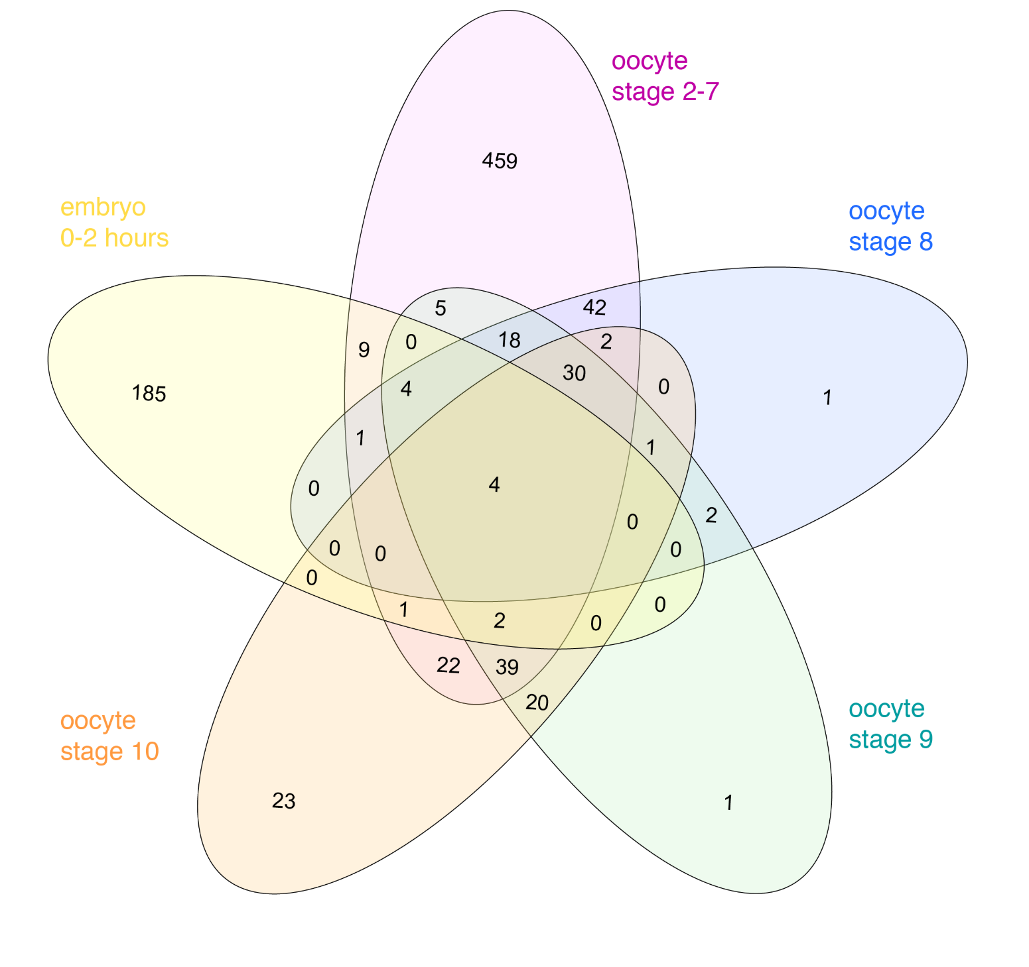
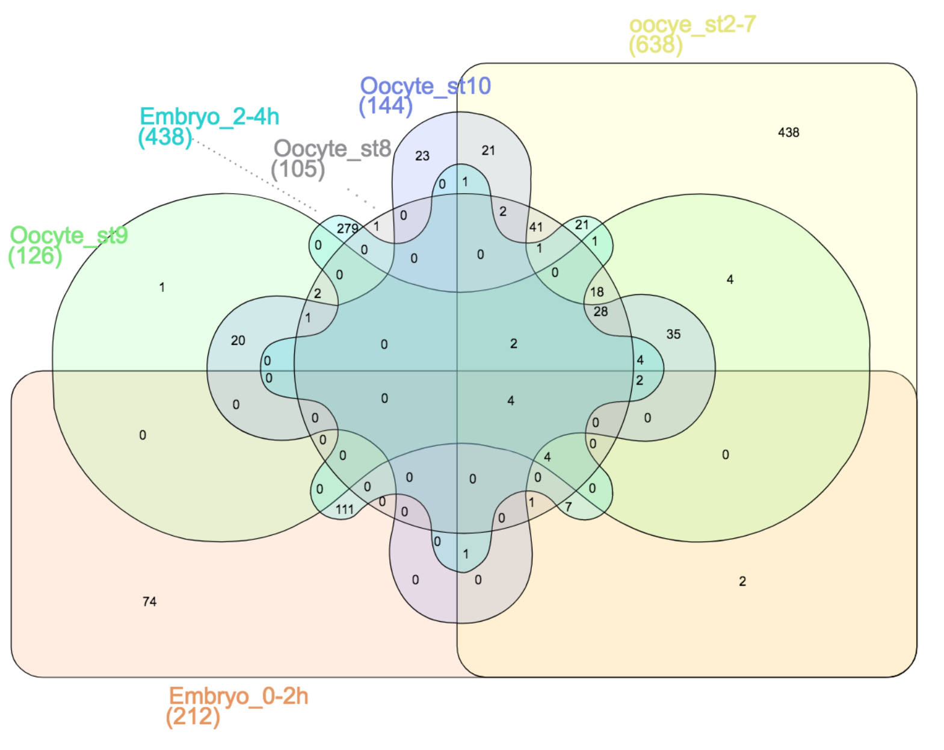
Venn diagram to show overlap for ≥ three sets
Web-based: Draw Venn (Yves Vandepeer, Univ of Gent) and InteractiVenn: a web-based tool for the analysis of sets through Venn diagrams (Heberle et al. BMC Bioinformatics, 2015)
R: nVennR: (Victor Quesada) – seems to be gone from CRAN
Try plotVenn
Notes:
Of course, we can visualize overlap of three sets in the same fashion.
The change is that we need to visualize 4 overlaps or set intersections.
Although it is a bit distracting or out of focus, it might be OK to present this if it comes with text describing what you want to show.

Slide 32
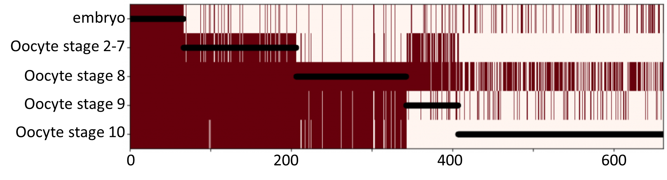
Heatmaps to draw overlap among > three sets
Expressed genes in the developmental stages
https://thenode.biologists.com/venn-euler-upset-visualize-overlaps-in-datasets/education/
Pros: Easy to check the overall pattern
Cons: Difficult to see amount of the overlaps

Slide 33
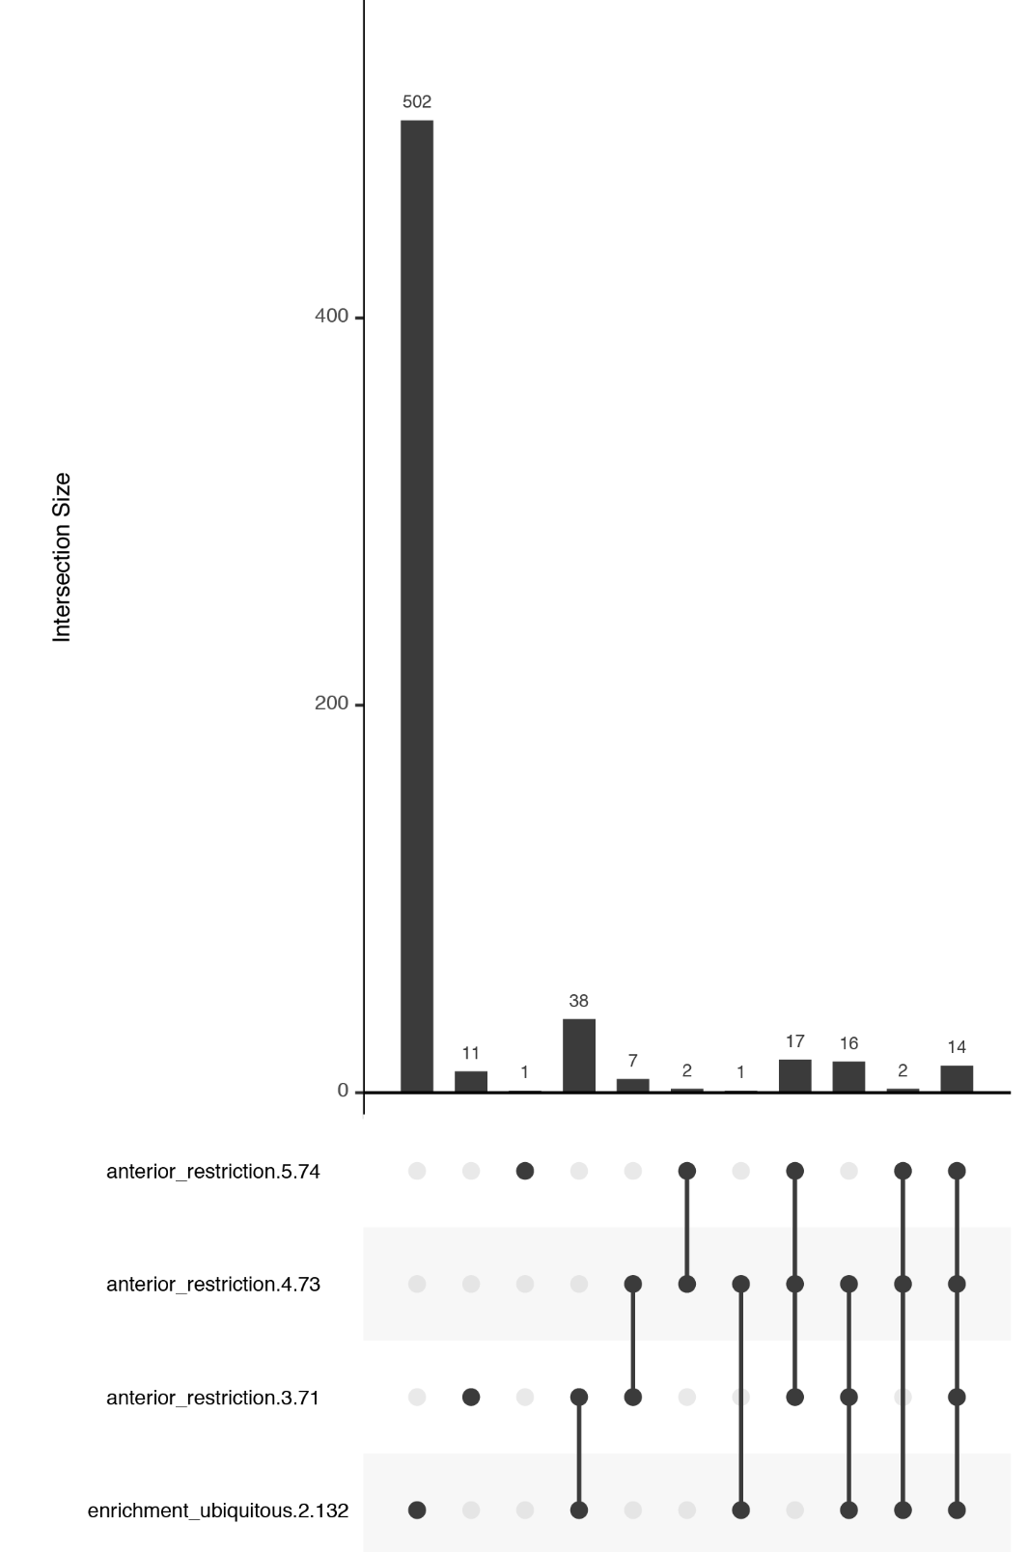
Upset plots to show overlaps among > three sets
Presence of dataset elements in a given intersection is shown in a table
The size of the intersection is represented with a bar chart
Available in R: UpSetR (Conway et al. Bioinformatics, 2017)
https://thenode.biologists.com/venn-euler-upset-visualize-overlaps-in-datasets/education/
Notes:
Based on the observation that not all combinations make intersections,
Both are simple visuals that are easy to consume. Their package is available in R and simple to use

Slide 34
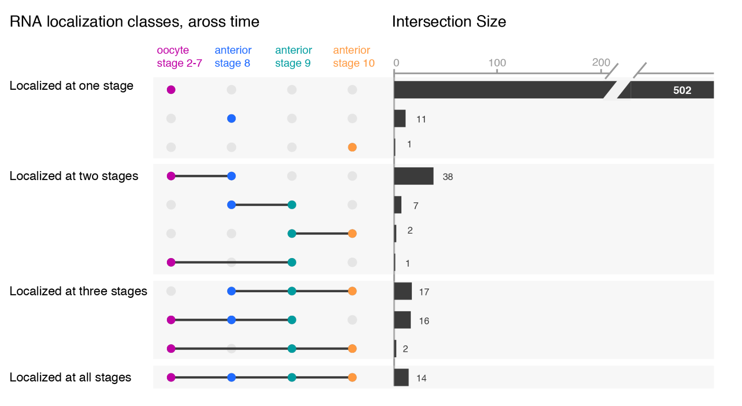
Upset plots to show overlaps among > three sets
Possible improvements:
Cutting the y-axis
Tilting the plot.
Group by the number of intersection
Color-code
https://thenode.biologists.com/venn-euler-upset-visualize-overlaps-in-datasets/education/
Notes:
While the upset plots are simple, I think they can be improved. In upset plots the intersect is shown above the actual datasets, that serve as the legend. Basically, one is forced to read the upset from the bottom up. By flipping the plot horizontally this caveat is overcome: now the datasets are on the left, where we typically read first, and the bar is shown on the right nicely accompanying the respective set. Another improvement is to clearly label the intersects e.g. “present in one set”, “two sets” and to group them visually. Additionally, I have also color-coded the datasets to provide a quicker way of orienting the reader.

Slide 35
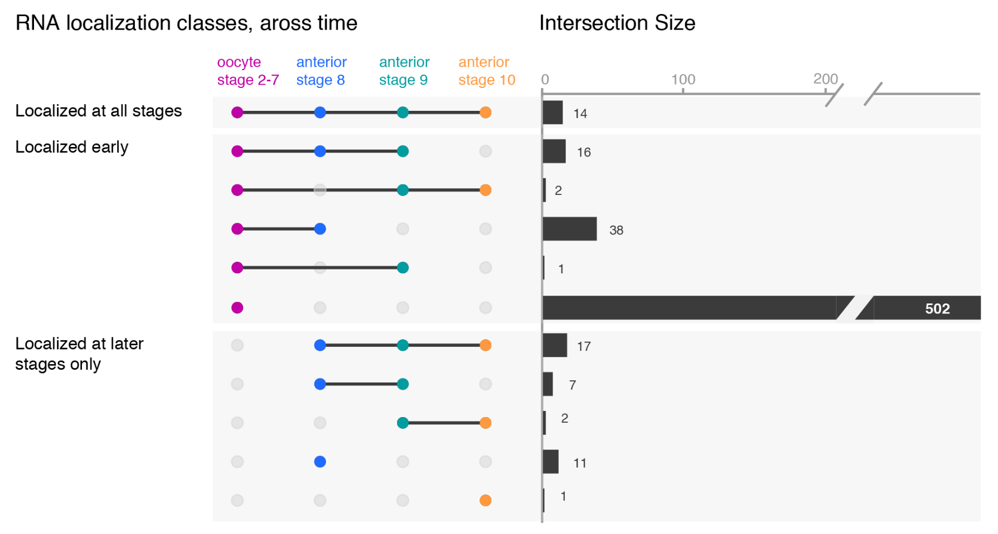
Upset plots to show overlaps among > three sets
The sorting order will reflect your point
e.g. RNAs localized early vs. late stages only
More suitable for exploration
https://thenode.biologists.com/venn-euler-upset-visualize-overlaps-in-datasets/education/
Notes:
While the upset plots are simple, I think they can be improved. In upset plots the intersect is shown above the actual datasets, that serve as the legend. Basically, one is forced to read the upset from the bottom up. By flipping the plot horizontally this caveat is overcome: now the datasets are on the left, where we typically read first, and the bar is shown on the right nicely accompanying the respective set. Another improvement is to clearly label the intersects e.g. “present in one set”, “two sets” and to group them visually. Additionally, I have also color-coded the datasets to provide a quicker way of orienting the reader.

